Slide 1


Notes:
LLL
Songs to Sing in the Shower – Spotify playlist
Put predevaluation link in the chat box & have students introduce themselves

Slide 2

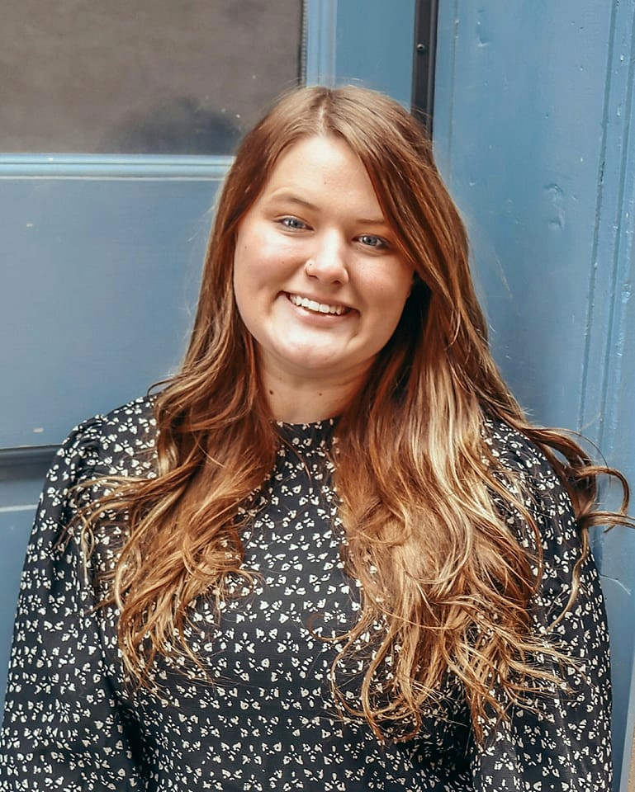
BELLA
LIBBY
Notes:
LLL – All introduce ourselves and share a fun fact

Slide 3

Group Norms
Be present
Questions, Questions, Questions
Vegas Rule
Share the airtime
Reserve the right to change your mind
Notes:
Self-Care Statement
Olivia

Slide 4
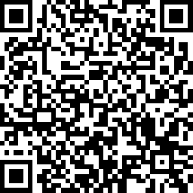
Pre-Test
Notes:
https://www.surveymonkey.com/r/SRPA2021 - OC

Slide 5
What is Bystander Intervention?
    by•stand•er in•ter•ven•tion
    Bystander Intervention is recognizing a potentially harmful situation or interaction and choosing to respond in a way that could positively influence the outcome. This means not only taking care of yourself, but also taking care of others.
Notes:
OC
Bystander – anyone who sees or hears about a behavior that could lead to something high risk or harmful.
Passive Bystanders – Those who choose to do nothing
Active Bystanders – Those who choose to DO SOMETHING to decrease the likelihood that something bad will occur or get worse.

Slide 6
4 things to remember...
Observe through the lens of a bystander
You could be connected to person involved
Focus on behaviors, not who is doing them
It’s better to check in and be wrong, than wonder
Notes:
Bella

Slide 7
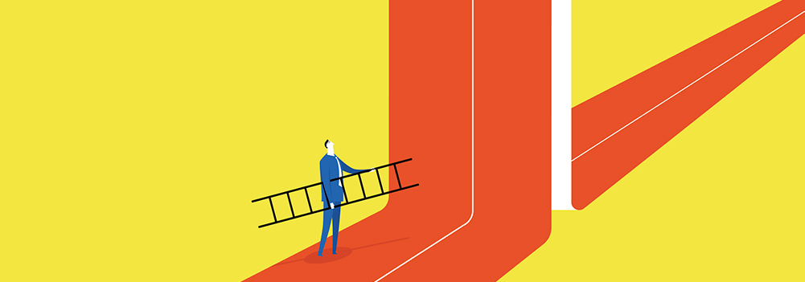
Understanding Barriers
Personal
Relationship or Social
Notes:
OC
Personal – being shy, introverted, or afraid of physical escalation or retaliation, or unsure or not wanting to make a scene or embarrass yourself. Identity can also be a personal barrier for folks.
Relationship or social – like being afraid of what family or friends will think, not wanting to break an unspoken rule in your group or family, or being the one who doesn’t know how to have a good time, or being afraid to break a family silence.
[Insert a personal barrier with an example of a time you did not act]. If there is time
Think of interventions that are REALISTIC for you, even WITH your barriers.

Slide 8

A Note on Safety
If you yourself are unsafe,
you cannot effectively intervene.
Notes:
OC
At a party or live in a duplex, don’t go knock on the door.

Slide 9
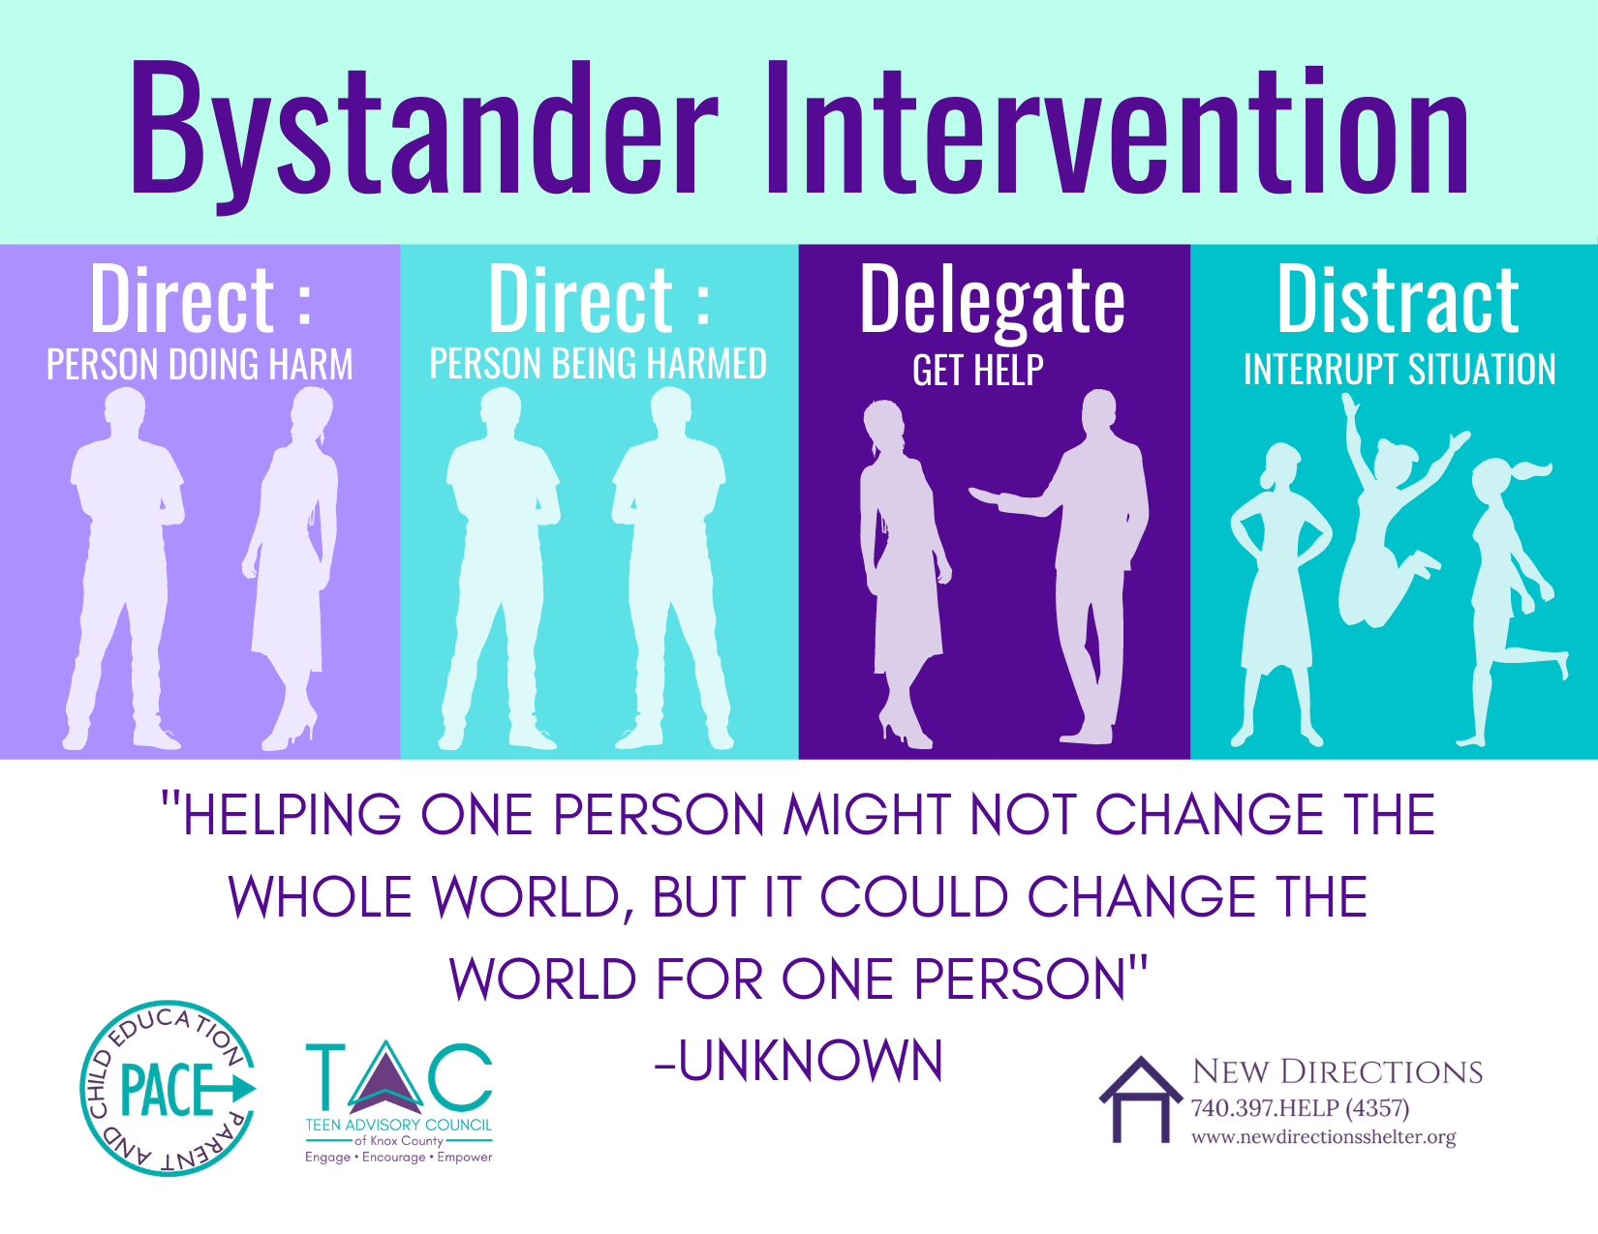
Notes:
OC
Direct: Do something yourself (like ask someone to stop what they are doing, or check on someone you might be worried about)
Distract: If you don’t want to address the situation directly or even acknowledge that you see it, try to think of a distraction that will diffuse the situation or calm things down in the moment. A distraction might be “accidentally” spilling your drink, or asking to borrow the phone of someone who is in a risky situation, or asking for a ride, or starting an unrelated conversation.
Delegate: If you can’t do something directly because of your barriers, ask their friends for help. Talk to a trusted family member, a pastor, law enforcement, or your boss. Tell the bartender or ask a family friend to check in. Leave an anonymous note for the supervisor
Activity set up:
Count off by fours (Lions, Tigers, Bears, Oh My!)
Assign each group a poster (Direct with P doing Harm, Direct with P being Harmed, Distract, Delegate)
Say: I am going to read a scenario. After I finish, please take 60 seconds to write interventions you could do that fit the category you are working on. Categories correspond with the 3 D’s we just talked about.
Read the 1st scenario and time 60 seconds.
Say: Would someone from each group read their ideas?
Rotate, rinse, repeat for as many scenarios as you have.
*4 scenarios allows each group to brainstorm each category of the 3 D’s

Slide 10
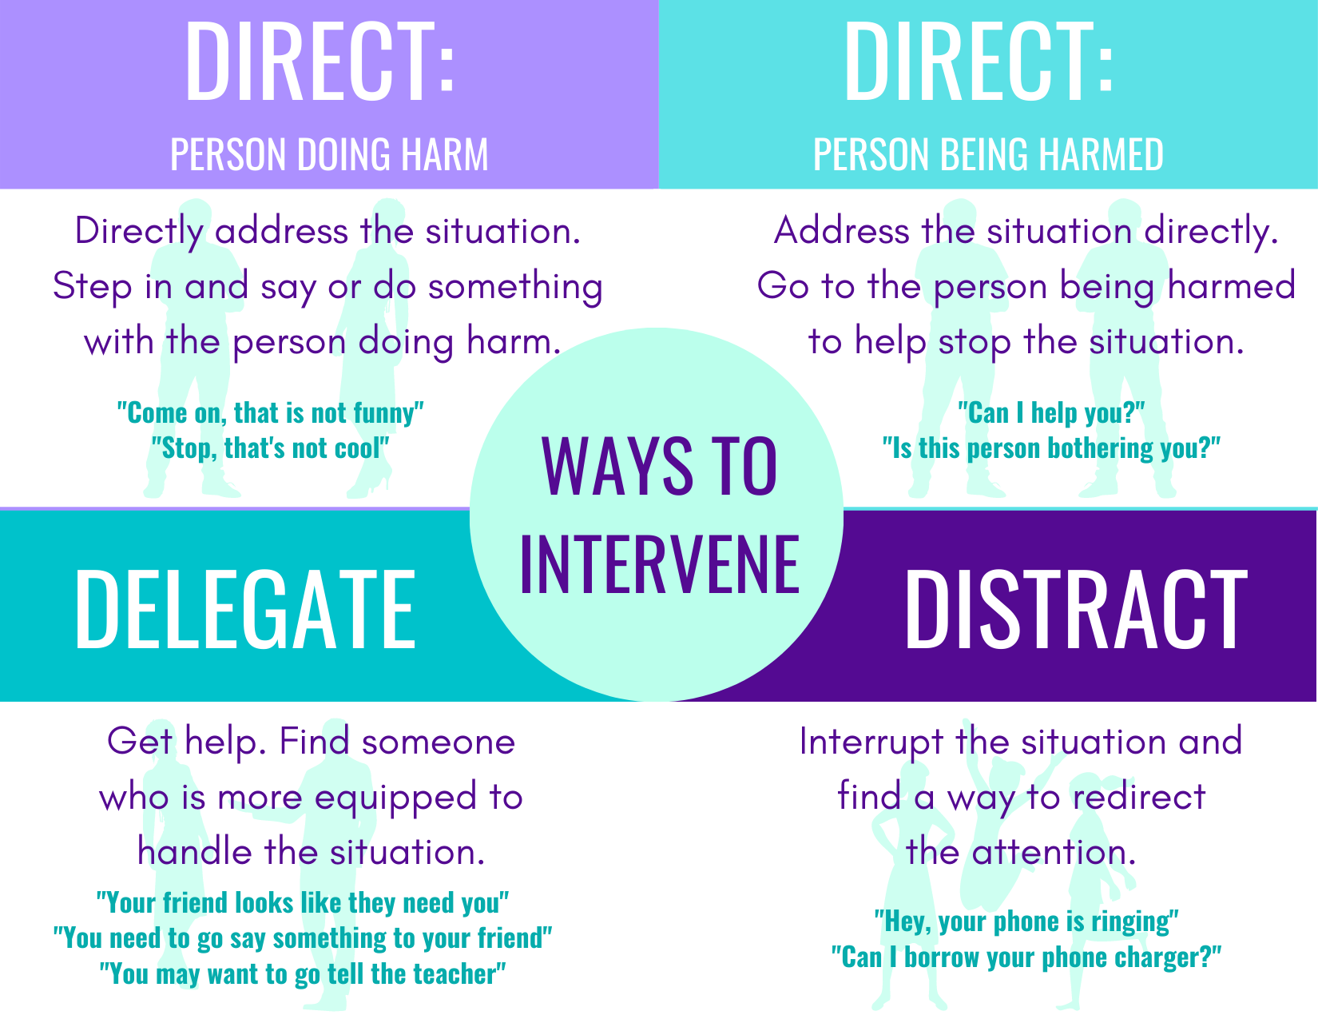
Notes:
OC

Slide 11

Time to Practice!
Notes:
LLL

Slide 12
You’re at a party and you notice a friend of yours is really drunk. There’s a guy pushing her more drinks and talking about taking her home.
What do you do?

Slide 13
You’re outside of your classroom and you see a couple you don’t know very well arguing. It looks like it’s about to get physical.
What are you most likely to do?

Slide 14
You’ve noticed that your co-worker’s ex is always waiting for him after work. He doesn’t seem excited to see her and he often stays late to avoid her.
What are you most likely to do?

Slide 15

Questions?
Notes:
Share tiktok videos – insert here

Slide 16
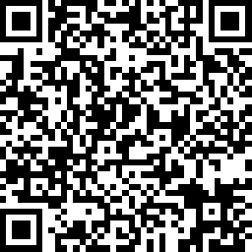
Please take a moment to fill out our survey!

Slide 17

Final Questions & Evaluation
Libby libby@newdirectionsshelter.org
Bella
bella@newdirectionsshelter.org

