Slide 1


Faculty Assembly Review 2023

Slide 2





Civil Rights Director
Christina Jones, J.D.
Lakeholm 109
Katie Sherman, Deputy TIX Coordinator

Slide 3

Notice of Non-Discrimination
Religious Expression
Who We Are and
What We Believe
Being of Wesleyan heritage, and a ministry of the Church of the Nazarene, we strive to be a learning community where grace is foundational, truth is pursued, and holiness is a way of life. Furthermore, we attempt to make all policies and decisions within the doctrinal and moral convictions of the Church of the Nazarene discrimination.
This integration of faith and learning is recognized by the United States and Ohio Constitutions and many state and federal laws. Therefore, it is a recognized right of religious educational institutions such as MVNU to incorporate religious beliefs into all aspects of university life and maintain faith-based standards of behavior which all community members voluntarily agree to follow.
Mount Vernon Nazarene University is committed to fostering a non-discriminatory campus environment in which community members can learn and work. MVNU prohibits discrimination on the basis of race, sex, age, color, national origin, disability, marital status, or military service in the operation of all University programs, activities, and services. As a faith-based institution, the University is exempted from certain laws and regulations concerning discrimination. The University maintains the right, with regard to its lifestyle covenant, employment, and other matters, to uphold and apply its Christian beliefs related to, among other issues, marriage, sex (gender), gender identity, sexual orientation, and sexual activity to the fullest extent permitted by law. Thus, MVNU attempts to make all policies and decisions within the doctrinal and moral convictions of the Church of the Nazarene (e.g., Articles of Faith, Covenant of Christian Conduct including the Statement on Human Sexuality and Marriage, Covenant of Christian Character, and the Statement on Discrimination, 915).

Slide 4

The RIPPLE Effect of Harassment
Just like a stone thrown into a pond, small actions can create ripples that spread out far beyond the first splash. With harassment, we often think about that first splash: the harsh confrontation, the initial hurt feelings, or even the physical wounds. We seldom see how that first splash might reverberate out in surprising ways.
Disrespectful behavior can have negative academic, emotional, social, and health consequences for all involved. And, without, intervention, those consequences can spread and grow.
- United Educators

Slide 5


The University encourages all members of its community to participate in the process of creating a safe, welcoming and respectful environment on campus.
To address harassment, you have to be able to recognize harassment: Harassment can occur in many ways and many different places, and it can be perpetuated by a wide range of individuals.
The problems is real: All occurrences are serious and unacceptable. Every student has the right to a respectful educational environment and every employee has the right a respectful work environment that is free from discrimination and harassment.
You play a vital role in preventing and stopping harassment: Whether you are standing up for yourself, supporting someone else, or simply not joining in, you set the example for others.
- United Educators

Slide 6

Civil Rights Policies
Discrimination, Harassment, Sexual Misconduct
Pregnancy Accommodations and Related Conditions
Resolving Complaints under ADA/Section 504
Find these at www.mvnu.edu/titleix

Slide 7

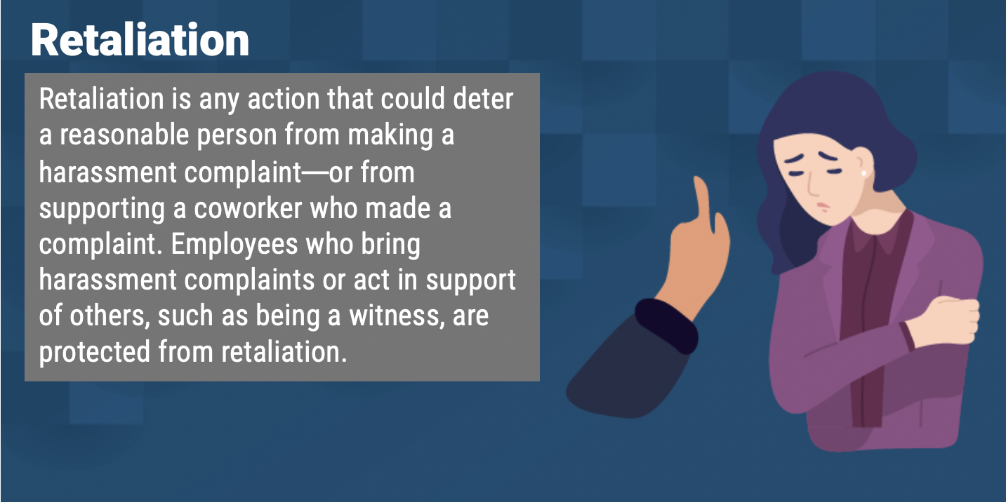

Title VI
Title VII
Title IX
ADA/504
Applies to all
students & employees
The Civil Rights Office is a policy driven entity and is designed to ensure that all its community members are free from discrimination and harassment as required by law and the University policies. The Policy prohibits specific forms of behavior, which the Policy collectively refers to as “Prohibited Conduct.”

Slide 8

What Is Discriminatory Harassment?
Prohibited Conduct
Discriminatory harassment can take many forms. It may be, but is not limited to: words, signs, jokes, pranks, intimidation, physical contact, or violence. It also may include harassment that is sexual in nature or directed at the gender of another (as in sexual harassment).
Do NOT create a HOSTILE environment!
Harassment may also be constituted by nonverbal acts that would also be punishable as, for example, vandalism, physical assault, or destruction of property. Other examples of harassment include epithets or "jokes" referring to an individual's group-based attributes; placement of offensive written or visual material on another's work area; offensive messages sent through email; and undesired physical contact, physical violence, or threat of same.
Is intended to insult or stigmatize an individual or an identifiable group?
Is it addressed directly to or at (though not necessarily in the presence of) the individual or individuals whom it insults or stigmatizes
Does it make use of words or nonverbal symbols that convey hatred or contempt for human beings on the basis of a protected characteristic?

Slide 9



Title IX – Sexual Harassment
    Quid Pro Quo
    Unwelcome Conduct
    Sexual Assault
    Dating Violence
    Domestic Violence
    Stalking
Conduct that does not meet these threshold requirements is subject to a Title IX Dismissal but may still be resolved as a Non-Title IX Sexual Misconduct.
Non-Title IX Sexual Assault
Sexual and Gender-Based Harassment
Sexual Exploitation
Non-Title IX Domestic Violence
Non-Title IX Dating Violence
Non-Title IX Stalking
v
For reported behavior to qualify as Prohibited Conduct under the Title IX- Sexual Harassment it must meet all of the following threshold requirements:
  In US
  Within the University’s education program or activity
  Complainant must be participating in or attempting to participate in the education program or activity

Slide 10


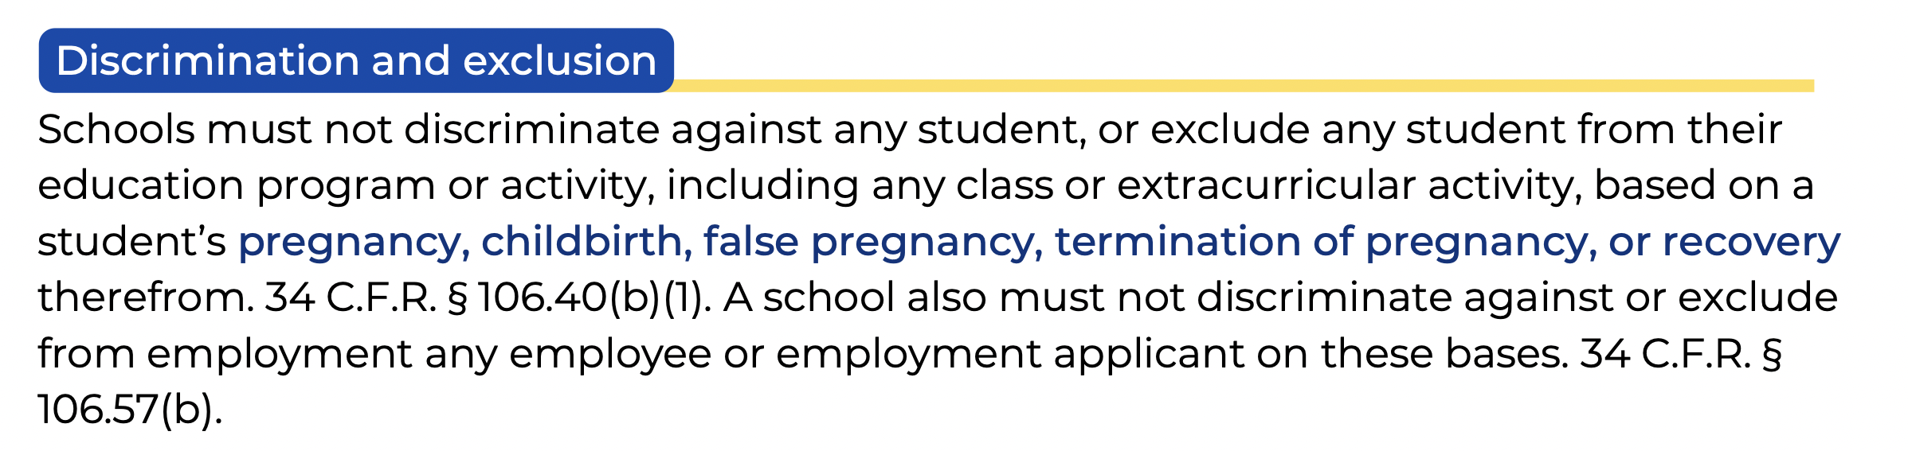


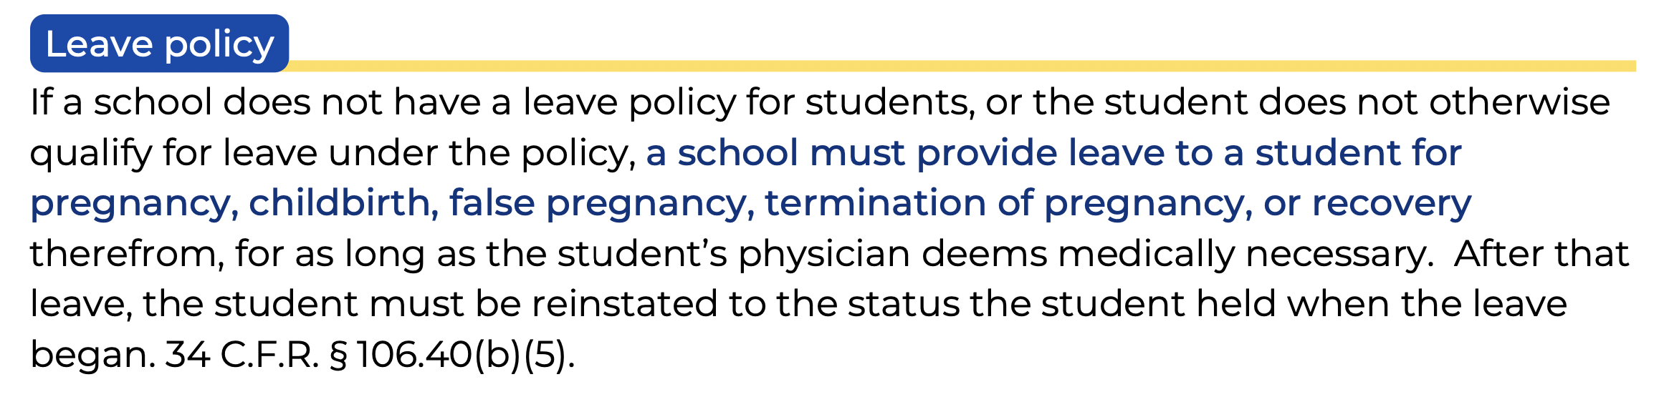
PREGNANCY ACCOMMODATIONS AND RELATED CONDITIONS FOR STUDENTS AND EMPLOYEES
Be a Good Neighbor
A school must ensure that teachers’ policies and practices do not discriminate against students because of pregnancy and related conditions. For example, a teacher may not refuse to allow a student to submit work after missing a deadline because of absences due to pregnancy or childbirth. Additionally, if a teacher’s grading is based in part on class attendance or participation, the student should be allowed to earn the missed credits and be reinstated to the student’s pre-leave status. OCR Pamphlet at 11.

Slide 11
PREGNANCY ACCOMMODATIONS AND RELATED CONDITIONS FOR STUDENTS AND EMPLOYEES
TITLE IX ADJUSTMENTS
Adjustments are time-limited for the period of the documented “medical necessity” per Title IX. They refer to options during and after pregnancy that provide for equitable access and ability to fully participate in academic programs, activities, practicums/field placements, and athletics.
Adjustments extend to parenting and primary caretaker of infant, and may include conditions arising from pregnancy, complicating pregnancy or resultant from pregnancy that might not otherwise be considered a disability/condition.
ADA/504 ACCOMMODATIONS
Accommodations require the presence of a “qualified” disability and/or condition per ADA/504. Pregnancy, alone, is not a disability. Pregnancy may be considered a temporary disability in certain circumstances under Section 504, or it may be considered a disability when one or more impairments related to pregnancy are present OR when a condition arising from pregnancy becomes long-lasting (i.e.: postpartum depression or gestational diabetes that becomes Type II) under ADA.
SUPPORTS
Extended deadlines Flexible exam scheduling
Excused absences
Grades of incomplete
Temporary parking in a closer location
Breaks for nursing/pumping
Job modifications, including reassignment to others of non-essential duties
Modified work schedule
Leave of absence Temporary assignment to a light duty position
Be a Good Neighbor
MVNU, through the Office of Civil Rights, supports pregnant students, faculty, and staff so they can achieve academic and work success while pregnant, recovering from birth of a child, caring for a newborn, and nursing an infant.

Slide 12



ADA /
Section 504
MVNU prohibits discrimination and harassment on the basis of disability.
It is covered in the Civil Rights Policy Resolving Complaints under the Disabilities Act and the Rehabilitation Act of 1973.
STUDENTS: Further information is available on MVNU’s Accessibility Student Policy webpage.
EMPLOYEES: Appropriate handbooks.
Grievance Procedures are found at www.mvnu.edu/titleix.
Accommodations are provided under the law.

Slide 13



Important Things to Know
How to report? ONLINE FORM OR IN PERSON
What to report? PROHIBITED CONDUCT
Who must report? MANDATED REPORTERS
Who are confidential resources? CAMPUS PASTORS, NURSE, COUNSELORS
What are supportive measures? NON-PUNITIVE SERVICES
What are the processes? FORMAL / INFORMAL
What is consent? CLEAR, KNOWING, VOLUNTARY
What is Bystander Intervention? STAND UP & SPEAK UP

Slide 14


Responding to Disclosure
Writing an Incident Report
Clarify role as a Mandated Reporter.
Remind them that you must report to the Civil Rights Director, but talking to the CRD is optional.
The CRD will keep the disclosure private.
Do NOT investigate! Do NOT mediate!
Listen. Support. Refer. Measures. Document.
Use the Incident Report Form online
Fill out the rest of the form to the best of your ability. As a mandated reporter you cannot report anonymously.
Be clear. Use first/last names. Avoid pronouns.
Report versus Formal Complaint
Complainants decide what, if anything, will happen.

Slide 15



CIVIL RIGHTS WEBPAGE: mvnu.edu/titleix/

Slide 16


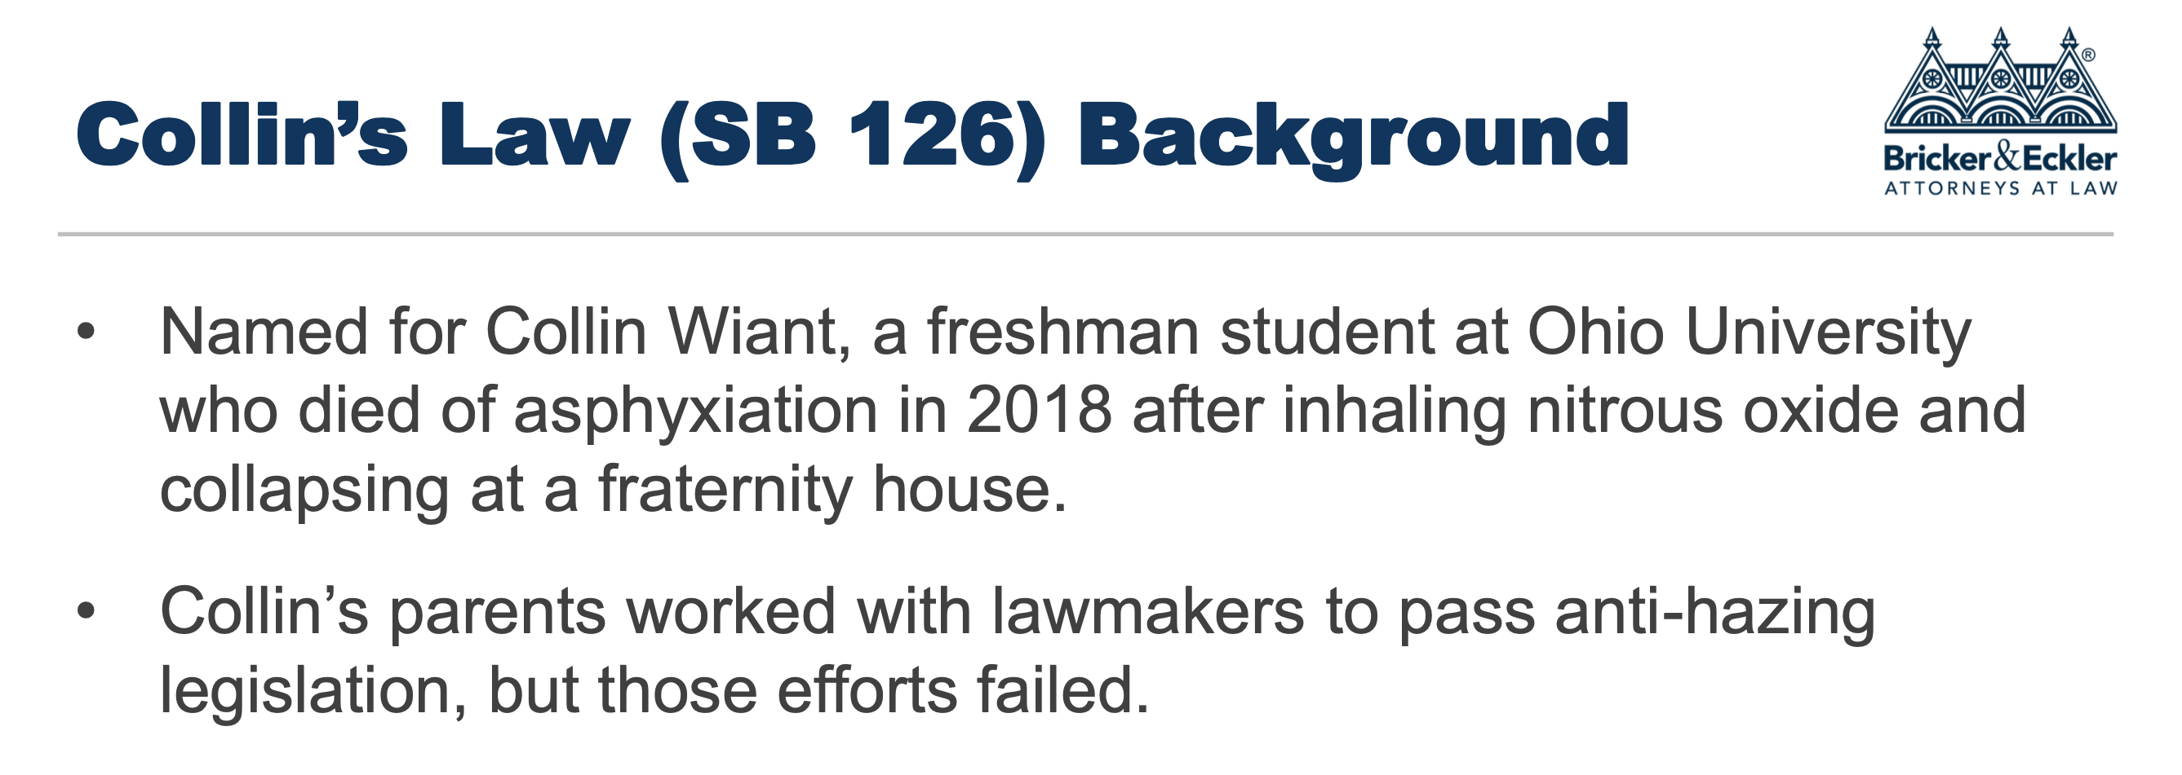
ANTI-HAZING POLICY
WHAT IS HAZING?
The Ohio Revised Code, Section 2903.31 defines hazing as: "doing any act or coercing another, including the victim, to do any act of initiation into any student or other organization or any act to continue or reinstate membership in or affiliation with any student or other organization that causes or creates a substantial risk of causing mental or physical harm to any person, including coercing another to consume alcohol or a drug of abuse, as defined in section 3719.011 of the Revised Code.
Notes:
Here’s an overview of how our discipline process works. [Click] (I’m loosing steam…)
Read. [Click]
Read [Click]
Read [Click]
Read [Click]

Slide 17



WHAT IS HAZING AT MVNU?
MVNU considers hazing to be any act which endangers the mental or physical health or safety of a student, or which destroys or removes public or private property for the purpose of initiation, admission into, or affiliation with, or as a condition for continued membership in a group or organization, whether the person subjecting to such behavior participates willingly or not.
Hazing acts may be physical, mental, emotional or psychological, which subjects another, to anything which may abuse, mistreat, degrade, humiliate, ridicule, harm, or intimidate.
STUDENT REPORTING
• Student Life Office
• Campus Safety
• Anonymous reports via Hazing Reporting Form
• If an emergency call 911.
EMPLOYEE REPORTING
“Mandatory Reporter” – not anonymous
Employee of MVNU
Any volunteer acting in an official capacity who advises or coaches student organizations
If a student does not complete this educational programming, they are PROHIBITED from participating in a recognized organization until the programming is completed.

Slide 18
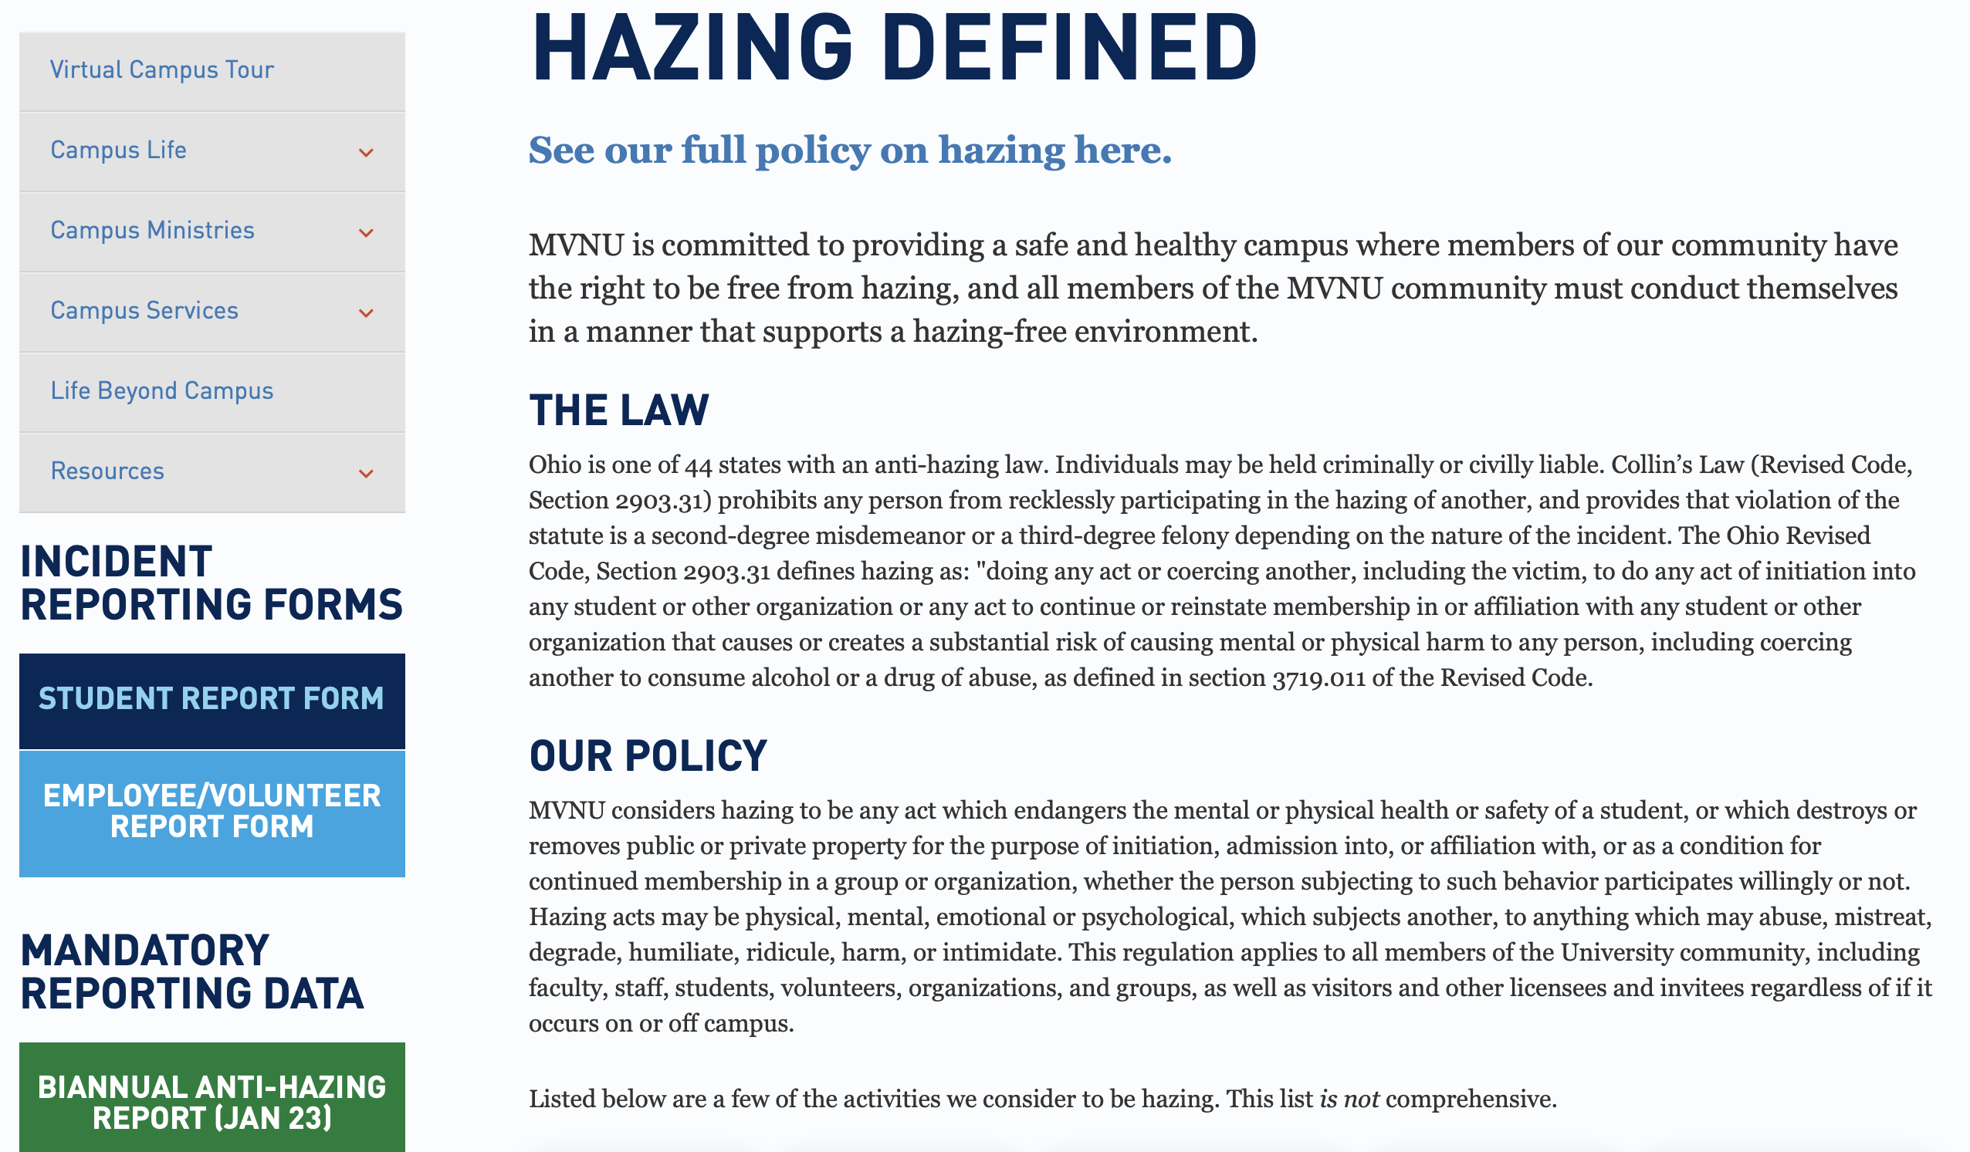

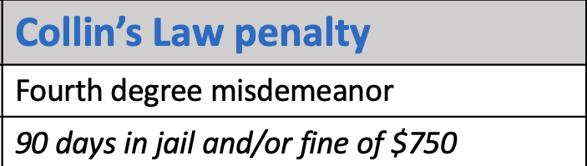
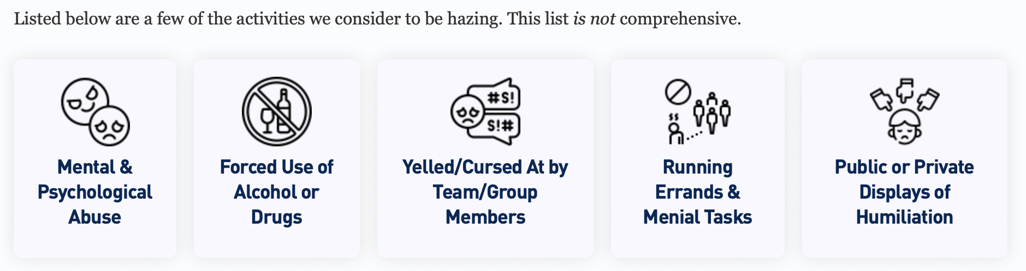
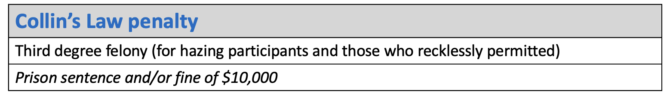

Hazing Penalties
Check out the Webpage @
https://www.mvnu.edu/studentlife/campuslife/hazing
RECKLESS PARTICIPATION
Prohibits administrators, employees, faculty members, teachers, consultants, alumni or volunteers from recklessly permitting the hazing of any person associated with an institutional organization.
COERCEED CONSUMPTION
Prohibits hazing that involves “coerced consumption of alcohol or drugs of abuse resulting in serious physical harm to that person.”

Slide 19


Scripture supports our training!
“You, my brothers and sisters, were called to be free. But do not use your freedom to indulge the flesh; rather, serve one another humbly in love. For the entire law is fulfilled in keeping this one command: “Love your neighbor as yourself.”
Gal. 5:13-14 (NIV)
Be a Good Neighbor

