Slide 1

Employee Training
August 2021

Slide 2

Sex/Gender-Based Harassment,
Discrimination and Sexual Misconduct
Policy & Procedures
Notes:
Maybe need to change this title

Slide 3

What is the Clery Act?
Enacted in 1990 - Colleges and Universities receiving Federal funding (student financial aid) must comply
Identified categories of crimes must be reported to the College
College must maintain a Daily Crime Log
College must publish an Annual Security Report (ASR)
College must publish crime statistics from the previous calendar year
Colleges must identify and train Campus Security Authorities (CSAs)
Notes:
Clery requires Title IX people to educate on what they’re responsible to report since Clery effects it.

Slide 4
Clery Act Categories of Crimes
Criminal Offenses
  Criminal homicide, murder, manslaughter, non-negligent manslaughter, sexual assault, rape, fondling, incest, statutory rape, robbery, aggravated assault, burglary, motor vehicle theft, arson
Hate Crimes
  Race, religion, sexual orientation, gender, gender identity, ethnicity, national origin, disability
VAWA Offenses
  Dating violence, domestic violence, stalking
Arrests & Referrals for Disciplinary Action
  Weapons, drug abuse, liquor law violations

Slide 5

Campus Security Authority (CSA)
Who is a CSA?
  Campus Safety
  Individuals specified to receive reports of Clery allegations
  Any official having significant responsibility for student and campus activities
How does a CSA fulfill their obligations?
  Report all Clery allegations to Campus Safety

Slide 6

Clery Reporting
When you think of Clery - think crimes and geography. There are specific categories of crimes that have to be tallied if the crime is reported and it occurred on property owned or controlled by MVNU.
Notes:
This includes University sponsored events, anything that has an effect on our campus community (community member)

Slide 7

What is VAWA?
Violence Against Women Reauthorization Act 2013
Does not just apply to women
Amends the Clery Act to include new categories of crimes on which colleges and universities (fed financial aid recipients) must collect:
  Dating Violence
  Domestic Violence
  Stalking
  Sexual Assault
Inform of the option to, or not to, notify law enforcement and campus authorities
Permits advisor of choice to be present at all meetings/interviews
Notes:
Shouldn’t sexual assault be here?

Slide 8
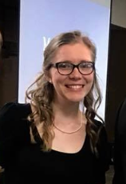
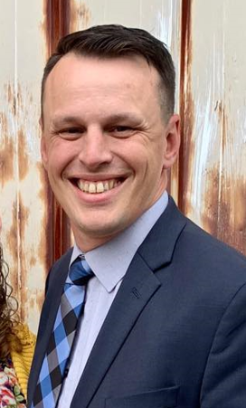
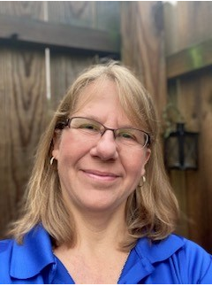
MVNU Title IX Team
740-399-8250 for off-campus callers
Extension 3250 for on-campus callers titleix@mvnu.edu
Title IX Coordinator
Katie Sherman
Responsible for monitoring compliance, solidifies interim measures and provides trainings and prevention programming.
Deputy Coordinator
Michael Simmons
Responsible for investigations and informal resolutions
Deputy Coordinator
Deb Oakes
Responsible for initial intakes when reports are submitted
Notes:
Highlight that we are not confidential resources. Move investigation unit to the processes

Slide 9

What is Title IX?
“No person in the United States, shall, on the basis of sex, be excluded from participation in, be denied the benefits of, or be subjected to discrimination under any educational program or activity receiving federal financial assistance.”
- Title IX of the Education Amendments of 1972

Slide 10
What Title IX is NOT
Not only for athletics
Not only for women
Not only about sexual assault

Slide 11
What is Title IX?
Environment free from harassment
  Speech, behavior, images
Schools Must:
    Stop -- the behavior
    Prevent -- the behavior from recurring
    Remedy – the effects of behavior

Slide 12
Scope of Policy
Title IX policy applies to all University employees and students.
Title IX:
Prohibited Conduct Occurring:
  In the United States
  A program or activity where MVNU has substantial control over both
    The context
    Respondent
    Sexual Harassment
      Quid Pro Quo
      Hostile Environment that is
        Severe
        Offensive
        Pervasive (wide spread)
Notes:
This stuff needs changed, depending on what Chris says.

Slide 13
Scope of Policy
Not Title IX (But still covered under our policy):
Prohibited Conduct Occurring:
  Anytime there is unwelcome, gender/sex conduct that adversely effects our students’ educational environment
  AND the conduct falls under the prohibited conduct in our Policy
Regardless of when, where or with whom the conduct occurred, the University will offer resources and assistance to any individuals who have been affected by Prohibited Conduct.
Notes:
Put a list of interim measures after this?

Slide 14
Prohibited Conduct
Sexual Harassment
Sex/Gender Discrimination (disparate treatment because of sex)
Sexual Assault
Non-Consensual Sexual Contact
Sexual Exploitation
Stalking (on the basis of sex)
Physical Harm and Intimidation
Cyber bullying (on the basis of sex)
Dating Violence
Domestic Violence
Retaliation
Notes:
Might need adjusted

Slide 15
Consent Defined
Must be informed, knowing and voluntary – freely given through clear words or action​
Cannot use force, threats, intimidating behavior, or coercion (unreasonable/persistent pressure).​
It cannot be given by someone known to be – or who should be known to be mentally or physically incapacitated.​
​
Consent requires the following conditions: ​
​
All parties are fully conscious.​
All parties are equally free to act.​
All parties have positively and clearly communicated their intent.

Slide 16
Minors on Campus
Prospective students are likely minors
CCP Students
Report any concerns to
  Title IX office
  Campus Safety
  Knox County Child Protective Services: 740-392-5437
Notes:
This really depends on jurisdiction. If we have control over the respondent and what's going on, both. So a guest group on campus may not fall into our jurisdiction because we don't put on the event. But, a sports camp over the summer, a campus visit, etc, would fall under Title IX.

Slide 17

Who is a Responsible Employee?
All MVNU employees EXCEPT those who are designated as confidential resources
Responsible Employees are required:
  Report any behavior of which you are aware, or reasonably aware, as soon as possible
  Report as much information as you know
    Names, behavior, location, etc.
Reports can be made to:
  TIX Coordinator or Deputy Coordinator
  Campus Safety – who will notify the TIX Coordinator

Slide 18
What a Responsible Employee
Must Say . . .
What a Responsible Employee Must Tell Someone Sharing information about Sex or Gender Discrimination or Misconduct Incident
Inform reporting party of:
  The Responsible Party’s obligation to report the information to the Title IX Coordinator
  Where they can report confidentially
  The right to file a Title IX-based complaint
  The right to report the crime to campus or local law enforcement

Slide 19

Confidential Resources
On Campus
Campus Counseling Center
Campus Pastor and Associate Pastor
Student Health Services
Off Campus
New Directions Domestic Abuse & Rape Crisis Center
Knox County Victim’s Assistance
National Domestic Violence Hotline
Ohio Sexual Violence Domestic Violence Hotline
Ohio Hispanic Coalition Domestic Violence Hotline

Slide 20

Sex/Gender-Based Harassment,
Discrimination and Sexual Misconduct
Policy & Procedure
The complete policy and the procedure can be found on the MVNU web page: https://www.mvnu.edu/titleix
  Reporting Options
  Amnesty
  Privacy
Notes:
Reporting options include in person to Title IX coor (preferred), to a responsible employee, online incident report, anonymous (limits to what we can do and cannot be done by an EE). Talk about amnesty policy here.

Slide 21
Writing a TIX Incident Report
Use the Incident Report Form online @ www.mvnu.edu/titleix
Fill out the rest of the form to the best of your ability. As a responsible employee you cannot report anonymously.
Be clear. Use first/last names. Avoid pronouns.
If you don’t know the exact date of the incident, indicate that in the narrative.
Notes:
Avoid pronouns- isn’t clear who you’re talking about

Slide 22
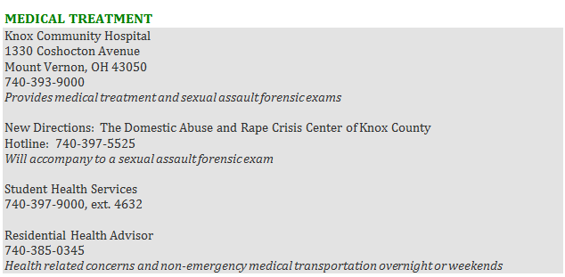
Medical Treatment
Get the student help
Contact Title IX Coordinator
If there is a scene, make sure it stays undisturbed
It is best practice for you to not transport them yourselves
Notes:
Transportation considerations

Slide 23

Responding to Disclosure
Clarify role as a Responsible Employee.
Remind them that you must report to the TIX C, but talking to the TIX C is optional.
The TIX C will keep the disclosure private.
Do NOT investigate! Do NOT mediate!
Listen. Support. Refer. Measures. Document.

Slide 24

The options available for the procedural process can be found on the webpage: www.mvnu.edu/titleix
  Inquiry/assessment
  Supportive Measures
  Formal Complaint Filed
  Informal Resolution
  Formal Resolution
  Investigation
  Hearing
  Appeal

Slide 25
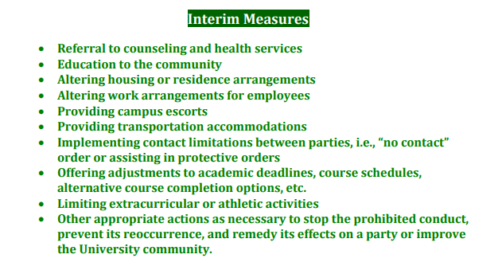
Supportive Measures

Slide 26
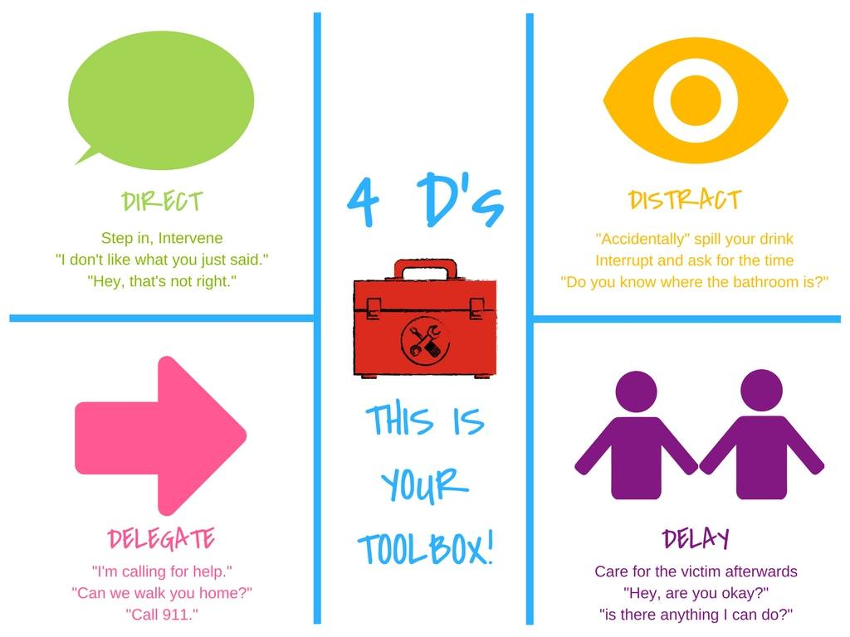
Bystander Intervention

Slide 27
Recognizing Trauma
  Anxiety/Depression​
  Low self-esteem​
  Reinforcements of stereotypes​
  Flashbacks​
  Disrupted sleep, loss of concentration​
  Suicidal thoughts/self-harming ​
  Breakdown in trust
Dizziness​
Dilated pupils​
Dry mouth​
Muscle tension​
Hyperventilation​
Rapid Speech​
Anxiety​
Floods of Emotion​
Unfocused eyes​
Disassociation​
Low energy​
Non-responsive

Slide 28
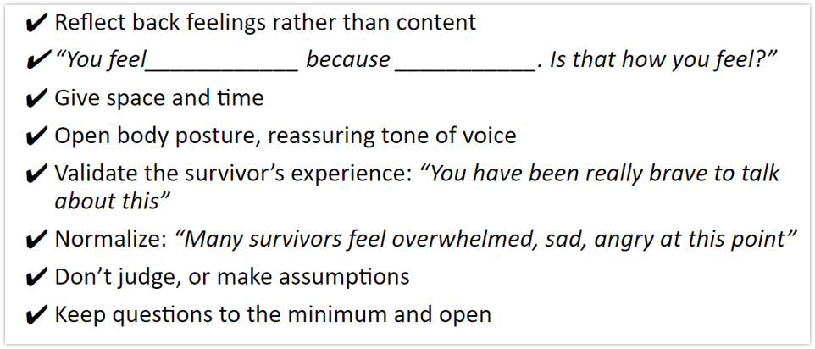
How do you help?
Be present, active listening, be patient​
Validate their feelings​
Offer resources​
  Counseling/Campus pastors, Title IX office support (adjust class schedules, police report, no-contact orders, room re-assignments, etc)

Slide 29
Grounding Techniques for those in Crisis
Grounding is a set of simple strategies that can help you detach from emotional pain (e.g.,anxiety, anger, sadness, self-harm). ​
It is basically a way to distract yourself by focusing on something other than the difficult emotions you are experiencing. ​
Although grounding does not solve the problem that is contributing to your unpleasant emotions, it does provide a temporary way to gain control over your feelings and prevent things from getting worse.

Slide 30
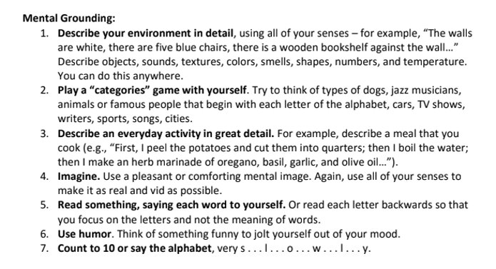
Grounding Techniques for those in Crisis

Slide 31
Building Culture
Pay attention to culture, and shut down conversations, jokes, actions, or media that you wouldn't want directed at you or a loved one.​
Step into situations that seem like they might be getting out of hand​
Continue to build trust and bonds with your group. ​
  In our student survey in 2016, 75% of people said they’d rather disclose to a friend than anyone else if they were to experience sexual violence.
Encourage Healthy Social Media habits
Tie this respect culture into our faith discussions

Slide 32

Notes:
Need general processes

