Slide 1

Student Leader Training
August 2021

Slide 2

What is Title IX?
“No person in the United States, shall, on the basis of sex, be excluded from participation in, be denied the benefits of, or be subjected to discrimination under any educational program or activity receiving federal financial assistance.”
- Title IX of the Education Amendments of 1972

Slide 3
What Title IX is NOT
Not only for athletics
Not only for women
Not only about sexual assault

Slide 4
What is Title IX?
Environment free from harassment
Speech, behavior, images
Schools Must:
Stop -- the behavior
Prevent -- the behavior from recurring
Remedy – the effects of behavior

Slide 5

Did you know?
More than 50 percent of college sexual assaults occur in August, September, October, or November, and students are at an increased risk during the first few months of their first and second semesters in college.

Slide 6
I'm a Student Leader. What does that mean for me in regards to Title IX?

Slide 7

Responsible Employee
Responsible Employees are required:
Report any behavior of which you are aware, or reasonably aware, as soon as possible
Report as much information as you know
Names, behavior, location, etc.
All MVNU employees EXCEPT those who are designated as confidential resources.

Slide 8
What a Responsible Employee Must Say . . .
Inform reporting party of:
The Responsible Party’s obligation to report the information to the Title IX Coordinator
Where they can report confidentially
Counseling and other support services
The right to report the crime to campus or local law enforcement
Notes:
Your RD is a need to know employee, must keep them in the loop, but otherwise you are responsible to keep the privacy of the person who discloses to you. Others who “need to know” will be determined in conjunction with student life and the Title IX Office.

Slide 9

Campus Security Authority (CSA)
What does being a Campus Security Authority mean?
To report to Campus Safety allegations of Clery Act crimes
Who is a CSA?
Campus Safety
Individuals specified to receive reports of Clery allegations
Any official having significant responsibility for student and campus activities
How does a CSA fulfill their obligations?
Report all Clery allegations to Campus Safety

Slide 10
What Do I Report?

Slide 11
Clery Act Categories of Crimes
Criminal Offenses
Criminal homicide, murder, manslaughter, non-negligent manslaughter, sexual assault, rape, fondling, incest, statutory rape, robbery, aggravated assault, burglary, motor vehicle theft, arson
Hate Crimes
Race, religion, sexual orientation, gender, gender identity, ethnicity, national origin, disability
VAWA Offenses
Dating violence, domestic violence, stalking
Arrests & Referrals for Disciplinary Action
Weapons, drug abuse, liquor law violations

Slide 12
Prohibited Conduct
Sexual Harassment
Sex/Gender Discrimination (disparate treatment because of sex)
Non-Consensual Sexual Intercourse
Non-Consensual Sexual Contact
Sexual Exploitation
Stalking
Physical Harm and Intimidation
Harassment, Bullying or Cyber bullying
Intimate Partner Violence
Retaliation

Slide 13
Scope of Policy
Title IX policy applies to all University employees and students, when engaged in University sponsored events on or off University property.
Prohibited Conduct Occurring:
On Campus
Within the context of any MVNU education program or activity
Has continuing adverse effects on campus, on members of the MVNU community
Regardless of where the conduct occurred when it occurs, i.e., on or off campus

Slide 14
Scope of Policy
Regardless of when, where or with whom the conduct occurred, the University will offer resources and assistance to any individuals who have been affected by Prohibited Conduct.

Slide 15

Not Within the Scope
Events occurring prior to arriving on campus
e.g., An assault that occurred during high school

Slide 16
Minors on Campus
Prospective students are likely minors
Report any concerns to
Campus Safety:
740-397-9000, Ext. 8686
740-399-8686
Knox County Child Protective Services: 740-392-5437

Slide 17
How Do I Report?

Slide 18

TIX Webpage

Slide 19
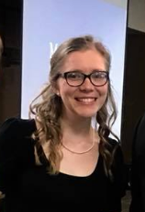
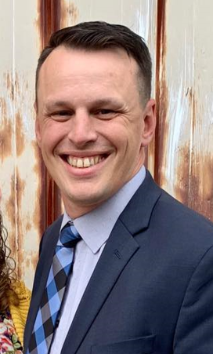
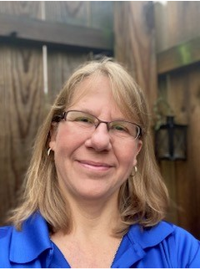
MVNU Title IX Team​ 740-399-8250 for off-campus callers​ Extension 3250 for on-campus callers​ titleix@mvnu.edu
Title IX Coordinator
Katie Sherman
Responsible for monitoring compliance, solidifies interim measures and provides trainings and prevention programming.
Deputy Coordinator
Michael Simmons
Responsible for investigations and informal resolutions
Deputy Coordinator
Deb Oakes
Responsible for initial intakes when reports are submitted

Slide 20

Writing a TIX Incident Report
Use the Incident Report Form online @ www.mvnu.edu/titleix
Fill out the rest of the
form to the best of your
ability. As a responsible
employee you cannot report anonymously.
Be clear. Use first/last names. Avoid pronouns.
If you don’t know the exact date of the incident, indicate that in the narrative.
Notes:
Avoid pronouns- isn’t clear who you’re talking about

Slide 21
What Do I Say When Someone Discloses to Me?

Slide 22

Responding to Disclosure
Clarify role as a Responsible Employee.
Remind them that you must report to the TIX C, but talking to the TIX C is optional.
The TIX C will keep the disclosure private.
Know your amnesty policy
Do NOT investigate! Do NOT mediate!
Listen. Support. Refer. Measures. Document.

Slide 23

Confidential Resources
On Campus
Campus Counseling Center
Campus Pastor and Associate Pastor
Student Health Services
Off Campus
New Directions Domestic Abuse & Rape Crisis Center
Knox County Victim’s Assistance
National Domestic Violence Hotline
Ohio Sexual Violence Domestic Violence Hotline
Ohio Hispanic Coalition Domestic Violence Hotline
Notes:
Make sure that they know that Hank is only a confidential EE in that role

Slide 24
What Happens After A Report is Made?

Slide 25
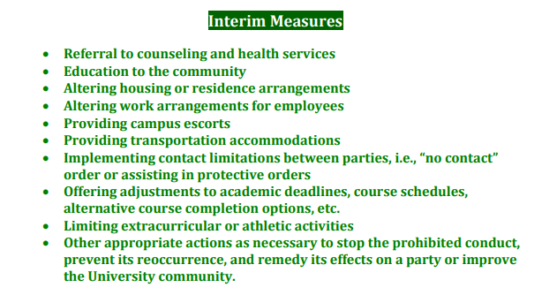
Interim Measures

Slide 26

The options available for the procedural process can be found on the webpage: www.mvnu.edu/titleix
Inquiry/assessment
Supportive Measures
Formal Complaint Filed
Informal Resolution
Formal Resolution
Investigation
Hearing
Appeal

Slide 27
Culture Building

Slide 28
Consent Defined
Must be informed, knowing and voluntary – freely given through clear words or action​
Cannot use force, threats, intimidating behavior, or coercion (unreasonable/persistent pressure).​
It cannot be given by someone known to be – or who should be known to be mentally or physically incapacitated.​
​
Consent requires the following conditions: ​ ​
1. All parties are fully conscious.​
2. All parties are equally free to act.​
3. All parties have positively and clearly communicated their intent.

Slide 29
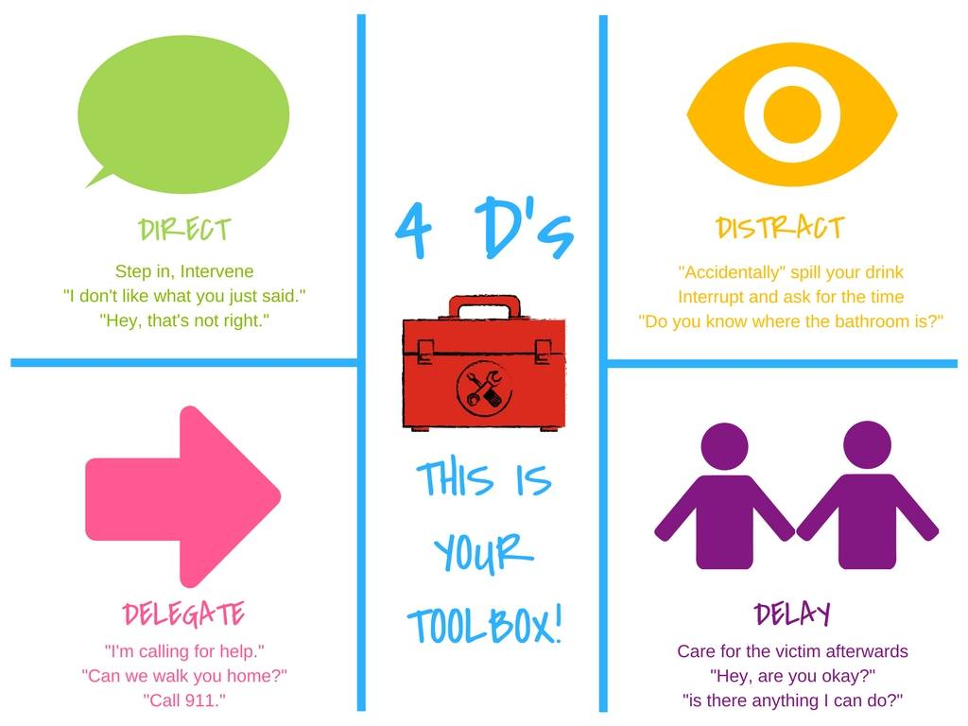
Bystander Intervention

Slide 30
Social Media
Imagine this scenario: You are seeing someone. You each decide to exchange nude selfies of each other. Life is good. Two weeks later you break up with the person. Do you trust the person whose heart you just broke to respect you enough not to share the photo on Instagram? Snapchat? Facebook? GroupMe?
You can be cyberbullied, stalked, sexually harassed via social media

Slide 31


What are some barriers that cause people to not report?
Do you have any barriers or biases?
How can we develop our
Student education and
Prevention programming?
Notes:
Shaming. Shouldn't have been wearing that. Shouldn't have been drinking.

Slide 32
Recognizing Trauma
Anxiety/Depression​
Low self-esteem​
Reinforcements of stereotypes​
Flashbacks​
Disrupted sleep, loss of concentration​
Suicidal thoughts/self-harming ​
Breakdown in trust
Dizziness​
Dilated pupils​
Dry mouth​
Muscle tension​
Hyperventilation​
Rapid Speech​
Anxiety​
Floods of Emotion​
Unfocused eyes​
Disassociation​
Low energy​
Non-responsive

Slide 33
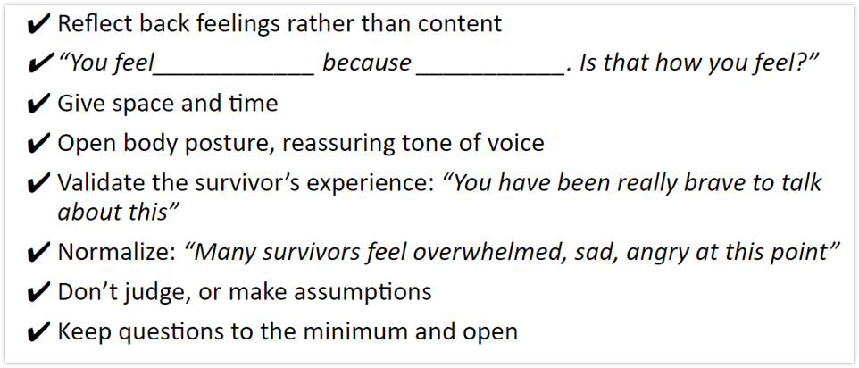
How do you help?
Be present, active listening, be patient​
Validate their feelings​
Offer resources​
Counseling/Campus pastors, Title IX office support (adjust class schedules, police report, no-contact orders, room re-assignments, etc)

Slide 34
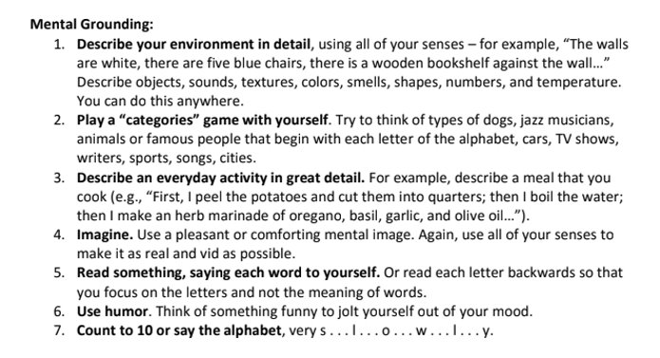
Grounding Techniques for those in Crisis

Slide 35
Building Culture
Pay attention to culture, and shut down conversations, jokes, actions, or media that you wouldn't want directed at you or a loved one.​
Step into situations that seem like they might be getting out of hand​
Continue to build trust and bonds with your group. ​
In our student survey in 2016, 75% of people said they’d rather disclose to a friend than anyone else if they were to experience sexual violence.
Encourage Healthy Social Media habits
Tie this respect culture into our faith discussions

Slide 36


