Slide 1

New Student Institute Training
2021

Slide 2

What is Title IX?
“No person in the United States, shall, on the basis of sex, be excluded from participation in, be denied the benefits of, or be subjected to discrimination under any educational program or activity receiving federal financial assistance.”
- Title IX of the Education Amendments of 1972

Slide 3
What Title IX is NOT
Not only for athletics
Not only for women
Not only about sexual assault

Slide 4
What is Title IX?
Environment free from harassment
  Speech, behavior, images
Schools Must:
    Stop -- the behavior
    Prevent -- the behavior from recurring
    Remedy – the effects of behavior

Slide 5

Did you know?
More than 50 percent of college sexual assaults occur in August, September, October, or November, and students are at an increased risk during the first few months of their first and second semesters in college.
Currently, it is estimated that approximately 11.2 % of all college students experience rape or sexual assault.
Women between the ages of 18 and 24 years old are at an elevated risk of sexual violence.
Nearly 85-90% of sexual assaults reported by college women in particular are perpetuated by someone known by the victim.
Notes:
https://www.rainn.org/statistics/victims-sexual-violencePreamble, p. 30076 (Official) notes that “Commenters cited: Rape, Abuse & Incest National Network (RAINN),
Campus Sexual Violence: Statistics, https://www.rainn.org/statistics/campus-sexual-violence.”
*Bricker and Eckler Training 2020 slides

Slide 6
What Do You Know?
MYTH OR FACT
Myth: A person who has really been sexually assaulted will be hysterical.
Fact: Response to assault can include: calm, withdrawal, anger, apathy, denial, and shock. Everyone responds to trauma differently
Myth: A person should immediately report to the police if they experienced a sexual assault.
Fact: A person has the right to decide how, when, and if they make a report. It is solely their decision and they should not be pressured to do anything they are not ready to do.

Slide 7
What Do You Know?
MYTH OR FACT
Myth: Men cannot experience sexual assault.
Fact: 1 out of every 10 rape victims are male
Myth: Someone is “asking for it” because of how they are dressed or dancing.
Fact: Phrases like that are a line of victim blaming. Dressing or dancing a certain way does not invite non-consensual activity.
Notes:
https://www.rainn.org/statistics/victims-sexual-violence

Slide 8
In keeping with our religious heritage, ethical convictions, and legislation, MVNU values a teaching, learning, and working environment that is free from discrimination, harassment, and misconduct.
Thus, MVNU takes its responsibilities toward
compliance with Title IX seriously.

Slide 9
What Kind of Things Should I Report?

Slide 10
Prohibited Conduct
Sexual Harassment
Sex/Gender Discrimination (disparate treatment because of sex)
Sexual Assault
Non-Consensual Sexual Contact
Sexual Exploitation
Stalking (on the basis of sex)
Physical Harm and Intimidation
Cyber bullying (on the basis of sex)
Dating Violence
Domestic Violence
Retaliation

Slide 11
Scope of Policy
Title IX policy applies to all University employees and students.
Title IX:
Sexual Harassment Occurring:
  In the United States
  In a program or activity where MVNU has substantial control over both the context and the alleged perpetrator

Slide 12

What it Title IX?
Title IX is the floor.
Our Commitment to Community builds upon that floor.
Notes:
Remember what Professor Swallow shared from MVNU’s Student Handbook:
Affirmations
WE LOVE GOD
2. WE RESPECT OTHERS
3. WE BELIEVE IN PERSONAL RESPONSIBILITY
These affirmations invite us to understand ourselves as stewards of our lives and our bodies and to humbly submit to the invitation of God to be holy as He is holy. As our University President, Dr. Henry Spaulding, reminds us: “These affirmations reflect MVNU's conviction that the biblical mandate for the holy life, to which God calls all believers, is summarized in the scriptural commands to "love the Lord thy God with all thy heart, soul, mind, and strength and thy neighbor as thyself"…In times like these, when Judeo- Christian values are no longer the moral centerpiece of our culture, we believe the need for a college that practices these standards is greater than ever…”
Our Commitment to Community makes the house we are building habitable…provides our walls, doors, windows, roof, etc.

Slide 13
Scope of Policy
Not Title IX (But still covered under our policy):
Prohibited Conduct Occurring:
  Anytime there is unwelcome, gender/sex conduct that adversely effects your educational environment
  AND the conduct falls under the prohibited conduct in our Policy
Regardless of when, where or with whom the conduct occurred, the University will offer resources and assistance to any individuals who have been affected by Prohibited Conduct.

Slide 14
What if something happens to me?
  We care about your well-being!
  We offer an amnesty provision – so if alcohol or some other minor policy infraction occurred that should not stop you from reporting.
  Privacy will be respected. Information related to an incident report will only be shared with those who “need to know” to assist with review and investigation and measures.
  We offer Confidential Resources, both on and off campus.

Slide 15
How Do I Report?

Slide 16
KNOW HOW TO REPORT
Use the Incident Report Form online @ https://www.mvnu.edu/titleix
Campus Safety
Contact the TIX Office
  Off Campus: 740-397-9000, Ext. 3250
  On Campus: 740-399-8250
  titleix@mvnu.edu

Slide 17
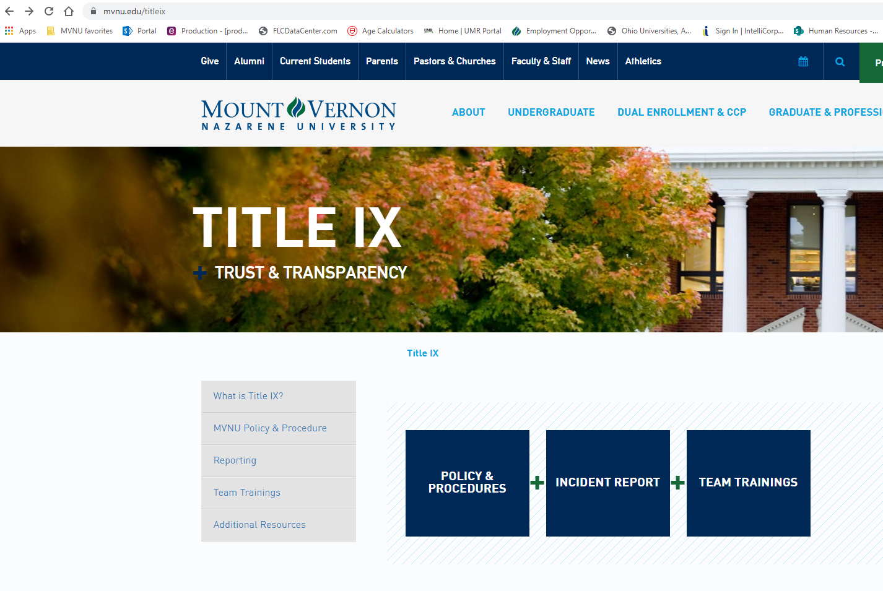

Slide 18
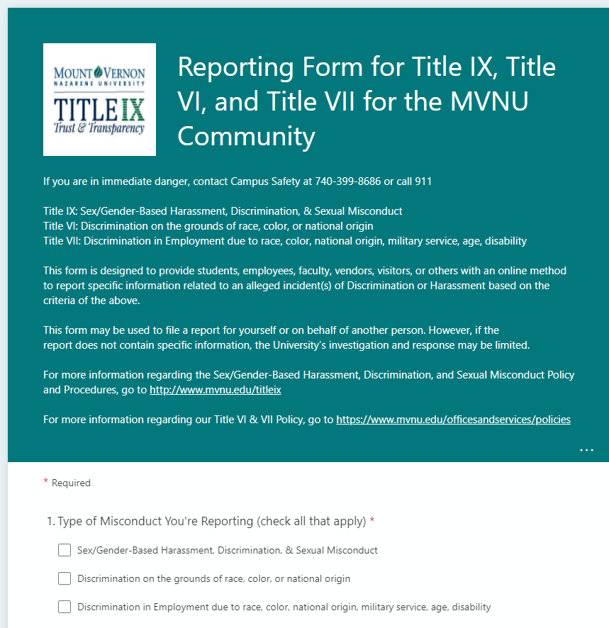

Slide 19
Non-Confidential Resources
All MVNU employees EXCEPT those who are designated as confidential resources.
Note – if you talk to a faculty member they MUST report any behavior of which they are aware, or reasonably aware, as soon as possible. The report needs to include names, behavior, location, etc.
Think "Privacy" instead of "Confidentiality"

Slide 20

Confidential Resources
On Campus
Campus Counseling Center
Campus Pastors
Student Health Services
Off Campus
New Directions Domestic Abuse & Rape Crisis Center
Knox County Victim’s Assistance
National Domestic Violence Hotline
Ohio Sexual Violence Domestic Violence Hotline
Ohio Hispanic Coalition Domestic Violence Hotline

Slide 21
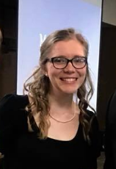
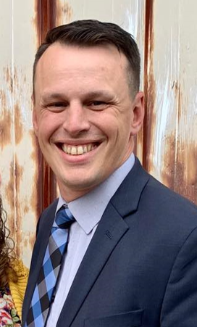
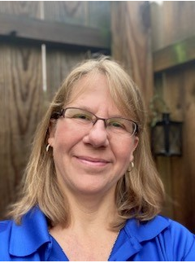
MVNU Title IX Team
740-399-8250 for off-campus callers
Extension 3250 for on-campus callers titleix@mvnu.edu
Title IX Coordinator
Katie Sherman
Responsible for monitoring compliance, solidifies interim measures and provides trainings and prevention programming.
Deputy Coordinator
Michael Simmons
Responsible for investigations and informal resolutions
Deputy Coordinator
Deb Oakes
Responsible for initial intakes when reports are submitted
Notes:
Highlight that we are not confidential resources. Move investigation unit to the processes

Slide 22
Sex/Gender-Based Discrimination, Sexual Misconduct, and Title IX Sexual Harassment Policy & Procedures
The complete policy and the procedure can be found on the MVNU web page: https://www.mvnu.edu/titleix

Slide 23
What Happpens After I Report?

Slide 24
KNOW YOUR RIGHTS
To REMEDY the effects of Prohibited Conduct
MVNU will offer resources and assistance known as SUPPORTIVE MEASURES.
  Referral to counseling and health services
  Altering housing or residence arrangements
  Providing transportation accommodations or campus escorts
  “No Contact” orders
  Offering adjustments to academic deadlines or course schedules
  Other appropriate actions as necessary

Slide 25

The options available for the procedural process can be found on the webpage: www.mvnu.edu/titleix
  Inquiry/assessment
  Supportive Measures
  Formal Complaint Filed
  Informal Resolution
  Formal Resolution
  Investigation
  Hearing
  Appeal

Slide 26
Culture Matters

Slide 27
Expectations of Personal Behavior
Student Handbook defines the Standards of Conduct expected of an MVNU student.
  The University expects Christian standards of morality to govern every personal relationship
  The University expects unquestioned honesty
  The use of alcoholic beverages, tobacco, and illegal drugs is prohibited

Slide 28

Impact of Drugs
& Alcohol
Lowers inhibitions
Affects the decision-making process
Impacts the awareness of consequences
Impacts a person’s ability to consent

Slide 29
CONSENT DEFINED
Must be informed, knowing and voluntary – freely given through clear words or action
Cannot use force, threats, intimidating behavior, or coercion (unreasonable/persistent pressure).
It cannot be given by someone known to be – or who should be known to be mentally or physically incapacitated.
Consent requires the following conditions:
1. All parties are fully conscious.
2. All parties are equally free to act.
3. All parties have positively and clearly communicated their intent.

Slide 30
What About When People are Drunk?
Impairment – being in a state that weakens clear thinking and decision making, but still able to function appropriately.
Incapacity – a person that is in a state of being unable to make decisions, understand what is happening, or function properly.
Slurred speech
Bloodshot eyes
Smell of alcohol on breath
Shaky equilibrium
Vomitting
Outrageous or unusual behavior
Unconsciousness

Slide 31
Social Media Issues
Imagine this scenario: You are seeing someone. You each decide to exchange nude selfies of each other. Life seems good. Two weeks later you break up with the person. Do you trust the person whose heart you just broke to respect you enough not to share the photo on Instagram? Snapchat? Facebook? GroupMe?
You can be cyberbullied, stalked, sexually harassed via social media
Don’t post, text, or send inappropriate images or messages.

Slide 32
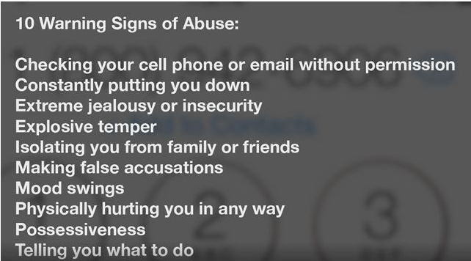
Recognizing Power Dynamics
Be on the alert for both you and your friends

Slide 33
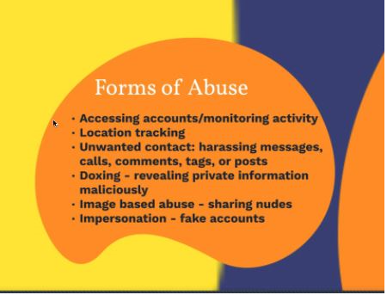

Slide 34
What Can I Do to Help Build a Safe and Respecful Culture?

Slide 35
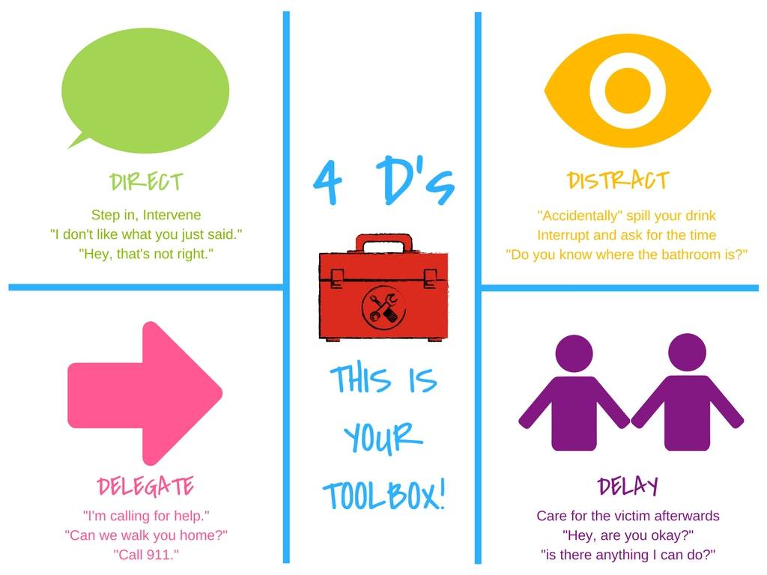
Bystander Intervention

Slide 36
Recognizing Trauma
  Anxiety/Depression​
  Low self-esteem​
  Reinforcements of stereotypes​
  Flashbacks​
  Disrupted sleep, loss of concentration​
  Suicidal thoughts/self-harming ​
  Breakdown in trust
Dizziness​
Dilated pupils​
Dry mouth​
Muscle tension​
Hyperventilation​
Rapid Speech​
Anxiety​
Floods of Emotion​
Unfocused eyes​
Disassociation​
Low energy​
Non-responsive

Slide 37
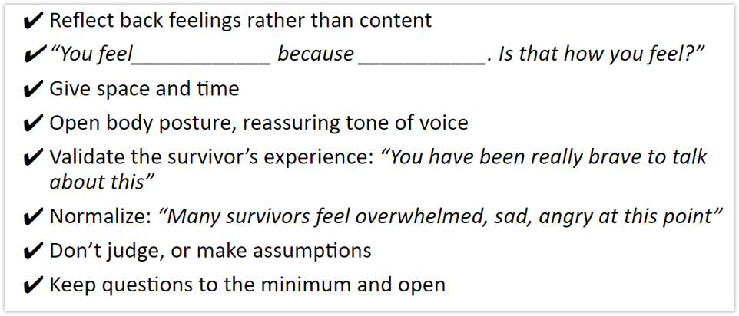
How do you help?
Be present, active listening, be patient​
Validate their feelings​
Offer resources​
  Counseling/Campus pastors, Title IX office support (adjust class schedules, police report, no-contact orders, room re-assignments, etc)

Slide 38


