Slide 1

New Faculty Orientation Training
August 2022

Slide 2

Religious Expression
Who We Are and What We Believe
Being of Wesleyan heritage, and a ministry of the Church of the Nazarene, we strive to be a learning community where grace is foundational, truth is pursued, and holiness is a way of life. Furthermore, we attempt to make all policies and decisions within the doctrinal and moral convictions of the Church of the Nazarene as articulated within the Manual of the Church of the Nazarene (e.g., Articles of Faith, Covenant of Christian Conduct including the Statement on Human Sexuality and Marriage, Covenant of Christian Character, and the agreed upon Statement on Discrimination, 915). We also strive to provide a learning and living environment that promotes safety, transparency, personal integrity, civility, mutual respect and freedom from unlawful discrimination.
This integration of faith and learning is recognized by the United States and Ohio Constitutions and many state and federal laws. Therefore, it is a recognized right of religious educational institutions such as MVNU to incorporate religious beliefs into all aspects of university life and maintain faith-based standards of behavior which all community members voluntarily agree to follow.
MVNU seeks to recruit students of the Christian faith and to create an institutional environment conducive to their growth in Christ; however, we do not require that students be confessing Christians. We welcome and value students of every background and faith. As a Christian community, we expect that all of our students will respect the nature of our community, learn about our traditions and participate in our community practices. MVNU affirms that a Christian liberal arts education includes an understanding of and appreciation of the differences in faith, living, and practice.

Slide 3

Notice of Non-Discrimination
Mount Vernon Nazarene University is committed to fostering a non-discriminatory campus environment in which community members can learn and work. MVNU prohibits discrimination on the basis of race, sex, age, color, national origin, disability, marital status, or military service in the operation of all University programs, activities, and services. As a faith-based institution, the University is exempted from certain laws and regulations concerning discrimination. The University maintains the right, with regard to its lifestyle covenant, employment, and other matters, to uphold and apply its Christian beliefs related to, among other issues, marriage, sex (gender), gender identity, sexual orientation, and sexual activity to the fullest extent permitted by law. Thus, MVNU attempts to make all policies and decisions within the doctrinal and moral convictions of the Church of the Nazarene (e.g., Articles of Faith, Covenant of Christian Conduct including the Statement on Human Sexuality and Marriage, Covenant of Christian Character, and the Statement on Discrimination, 915).

Slide 4
2 Civil Rights Policies
Discrimination, Harassment, Sexual Misconduct
Resolving Complaints under ADA/Section 504
Find these at www.mvnu.edu/titleix

Slide 5

MVNU is committed to fostering a climate free from discrimination and harassment, through clear and effective policies, a coordinated education and prevention program, and prompt and equitable procedures for resolution of reports of conduct prohibited under this policy. The University encourages all members of its community to participate in the process of creating a safe, welcoming and respectful environment on campus.
Title VI, 42 U.S.C. § 2000d et seq., was enacted as part of the landmark Civil Rights Act of 1964. It prohibits discrimination on the basis of race, color, and national origin in programs and activities receiving federal financial assistance.
Title VII, 42 U.S.C. § 2000e et seq., of the Civil Rights Act of 1964 helps protect individuals from discrimination in the workplace. It prohibits employment discrimination based upon race, color, national origin, sex and religion. Title VII also protects against harassment, which can be any physical or vocal conduct that creates an intimidating, hostile or offensive work environment. Conduct can be harassment if it interferes with a person's work performance.
Title IX, 20 U.S.C. §1681 et seq., of the Title IX of the Education Amendments of 1972 protects people from discrimination based on sex in education programs or activities that receive federal financial assistance.
ADA (The Americans with Disabilities Act of 1990), 42 U.S.C. §12101 and the Rehabilitation Act of 1973, Section 504 is a civil rights law that prohibits discrimination against people with disabilities in programs that receive financial assistance

Slide 6

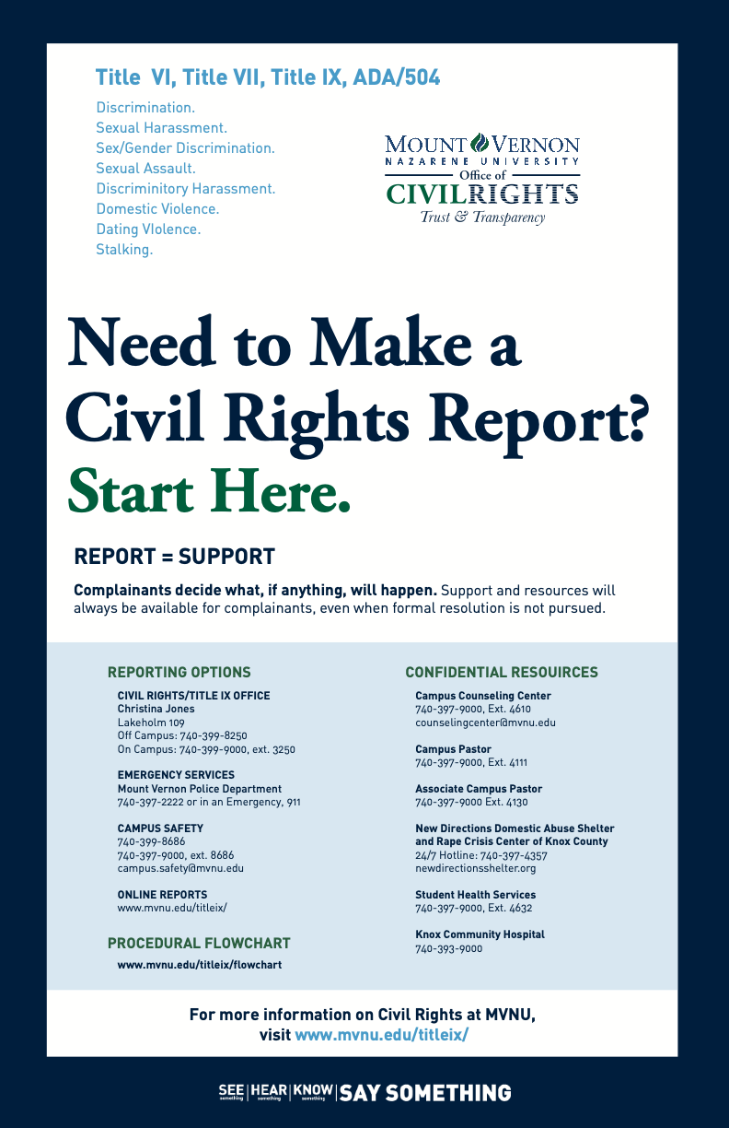
CAMPUS POSTER
STOP
  Stop the discrimination or harassment
PREVENT
  Prevent the reoccurrence
REMEDY
  Remedy the effect

Slide 7
Civil Rights Policy
Discrimination, Harassment, Sexual Misconduct
Title VI, Title VII, Title IX
Applies to all University students and employees
The Civil Rights Office is a policy driven entity and is designed to ensure that all its community members are free from discrimination and harassment as required by law and the University policies. The Policy prohibits specific forms of behavior, which the Policy collectively refers to as “Prohibited Conduct.”
This policy applies to all forms of Prohibited Conduct that:
  Occur on campus;
  Occur in any MVNU education or employment activities and programs; or
  Have continuing adverse effects on campus, on any member of the MVNU community, or in the context of any MVNU education or employment activities and programs, regardless of where the conduct occurred.
Let’s take a look at PROHIBITED CONDUCT under the policy

Slide 8

Title VI – Racial Discrimination
At MVNU, we believe that God is the Creator of all people. As we are made in His image, we believe that embracing and celebrating diversity brings us all closer together. As a ministry of the Church of the Nazarene we renounce any form of racial and ethnic indifference, exclusion, subjugation, or oppression as a grave sin against God and our fellow human beings (Manual, 915). Our campus community benefits from the diversity of students, staff, and faculty. We are a community of individuals who seek to learn from, and about, one another. Diversity is expressed through racial, ethnic, age, ability, geographic, gender, cultural, and socioeconomic differences among the campus community. To such ends, MVNU will not tolerate violence, aggression or discrimination against members of its community on the basis of one’s race, skin color, or national origin.

Slide 9

What Is Discriminatory Harassment?
Prohibited Conduct
Discriminatory harassment can take many forms. It may be, but is not limited to: words, signs, jokes, pranks, intimidation, physical contact, or violence. It also may include harassment that is sexual in nature or directed at the gender of another (as in sexual harassment).
Is intended to insult or stigmatize an individual or an identifiable group?
Is it addressed directly to or at (though not necessarily in the presence of) the individual or individuals whom it insults or stigmatizes
Does it make use of words or nonverbal symbols that convey hatred or contempt for human beings on the basis of a protected characteristic?
Harassment may also be constituted by nonverbal acts that would also be punishable as, for example, vandalism, physical assault, or destruction of property. Other examples of harassment include epithets or "jokes" referring to an individual's group-based attributes; placement of offensive written or visual material on another's work area; offensive messages sent through email; and undesired physical contact, physical violence, or threat of same.
Do NOT create a HOSTILE environment!

Slide 10



What Do I Report?
Prohibited
Conduct
Criminal Offenses
  Criminal homicide, murder, manslaughter, non-negligent manslaughter, sexual assault, rape, fondling, incest, statutory rape, robbery, aggravated assault, burglary, motor vehicle theft, arson
Hate Crimes
  Race, religion, sexual orientation, gender, gender identity, ethnicity, national origin, disability
VAWA (Violence Against Women Reauthorization Act) Offenses
  Dating violence, domestic violence, stalking
Arrests & Referrals for Disciplinary Action
  Weapons, drug abuse, liquor law violations
Let’s take a look at more PROHIBITED CONDUCT under the policy.

Slide 11

Title IX – Sexual Harassment
    Quid Pro Quo
    Unwelcome Conduct
    Sexual Assault
    Dating Violence
    Domestic Violence
    Stalking
For reported behavior to qualify as Prohibited Conduct under the Title IX- Sexual Harassment it must meet all of the following threshold requirements:
  The conduct must have occurred against a person in the United States.
  The conduct must have occurred within the University’s education program or activity. For purposes of this provision, this means that the conduct must have occurred either (a) in a location, event, or circumstances over which MVNU exercised substantial control over both the respondent and the context in which the sexual harassment occurs or (b) in relation to a building owned or controlled by a student organization that is officially recognized by the MVNU.
  The complainant must be participating in or attempting to participate in the education program or activity of the University at the time the formal complaint is filed.

Slide 12
Conduct that does not meet these threshold requirements is subject to a Title IX Dismissal, but may still be resolved as a Non-Title IX Sexual Misconduct.
Non-Title IX Sexual Assault
Sexual and Gender-Based Harassment
Sexual Exploitation
Non-Title IX Domestic Violence
Non-Title IX Dating Violence
Non-Title IX Stalking

Slide 13



ADA / Section 504
While the University prohibits discrimination and harassment on the basis of disability, it is covered in the Civil Rights Policy Resolving Complaints under the Disabilities Act and the Rehabilitation Act of 1973.
STUDENTS:
Further information is available on MVNU’s Accessibility Student Policy webpage.
EMPLOYEES:
Appropriate handbooks.
Grievance Procedures are found at www.mvnu.edu/titleix.

Slide 14
MANDATED REPORTER
Previously referred to as responsible employees.
All University employees, student employees, and affiliated individuals are required to disclose to the Civil Rights Office any report of harassment or discrimination of which they are aware to ensure the University is able to provide a prompt, thorough, and supportive response.
Confidential resources are exempt from this requirement.
Mandated reports do not require that complainants take any specific course of action, or any action at all, with regard to any process under this Policy.
If YOU are a student leader or work at MVNU you are required to report an incident as soon as you know about it and as much as you know.
REPORT = SUPPORT

Slide 15
What a Mandated Reporter Must Say . . .
What a Mandated Reporter Must Tell Someone Sharing information about a possible Prohibited Conduct
Inform reporting party of:
  Their obligation to report the information to the Civil Rights Director
They may inform them of:
  Where they can report confidentially
  Counseling and other support services
  The right to file a complaint
  The right to report the crime to campus or local law enforcement
Notes:
Your RD is a need to know employee, must keep them in the loop, but otherwise you are responsible to keep the privacy of the person who discloses to you. Others who “need to know” will be determined in conjunction with student life and the Title IX Office.

Slide 16

Responding to Disclosure
Clarify role as a Mandated Reporter.
Remind them that you must report to the Civil Rights Director, but talking to the CRD is optional.
The CRD will keep the disclosure private.
Do NOT investigate! Do NOT mediate!
Listen. Support. Refer. Measures. Document.

Slide 17

Confidential Resources
On Campus
Campus Counseling Center
Campus Pastor and Associate Pastor
Student Health Services
Off Campus
New Directions Domestic Abuse & Rape Crisis Center
Knox County Victim’s Assistance
National Domestic Violence Hotline
Ohio Sexual Violence Domestic Violence Hotline
Ohio Hispanic Coalition Domestic Violence Hotline
More Resources at mvnu.edu./titleix

Slide 18
How Do I Report?
Civil Rights Director / TIX Coordinator / 504 Coordinator
  Lakeholm 109
  Off Campus: 740-399-8250 / On Campus: 740-399-9000, ext. 3250
  www.mvnu.edu/titleix
Campus Safety (24-hour availability)
  On Campus: 740-399-8686
  Off Campus: 740-399-9000, ext. 8686
  campus.safety@mvnu.edu
Any Non-Confidential University employee
Online Incident Report form at www.mnvu.edu/titleix

Slide 19
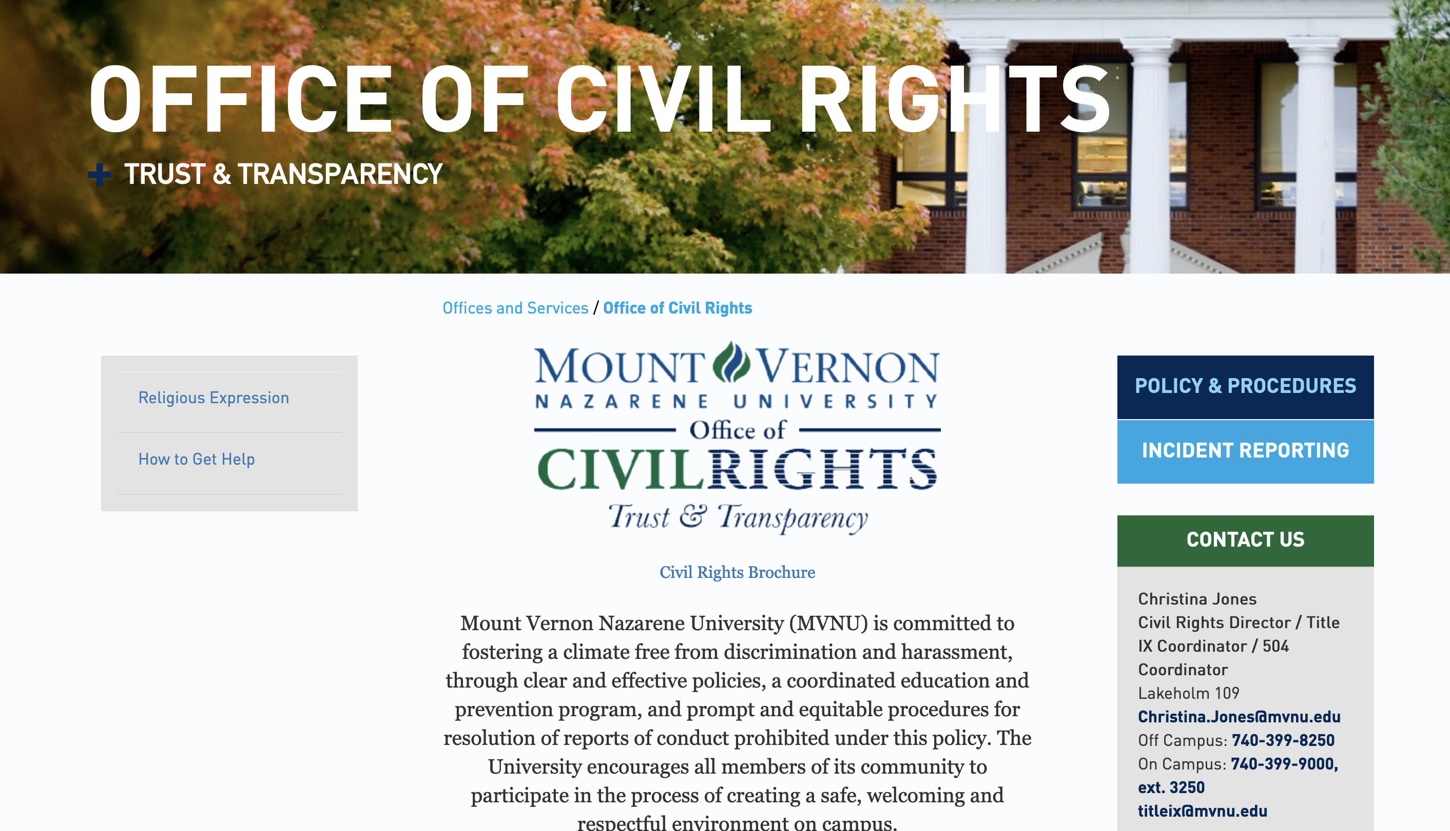
Civil Rights Webpage

Slide 20


Writing an Incident Report
Use the Incident Report Form online @ www.mvnu.edu/titleix
Fill out the rest of the form to the best of your ability. As a mandated reporter you cannot report anonymously.
Be clear. Use first/last names. Avoid pronouns.
If you don’t know the exact date of the incident, indicate that in the narrative.
Report versus Formal Complaint
Notes:
Avoid pronouns- isn’t clear who you’re talking about

Slide 21
There are three tracks that may be pursued if a formal complaint is lodged with the Civil Rights Office.
Informal Resolution Process
Investigator Resolution Process
Hearing Resolution Process

Slide 22

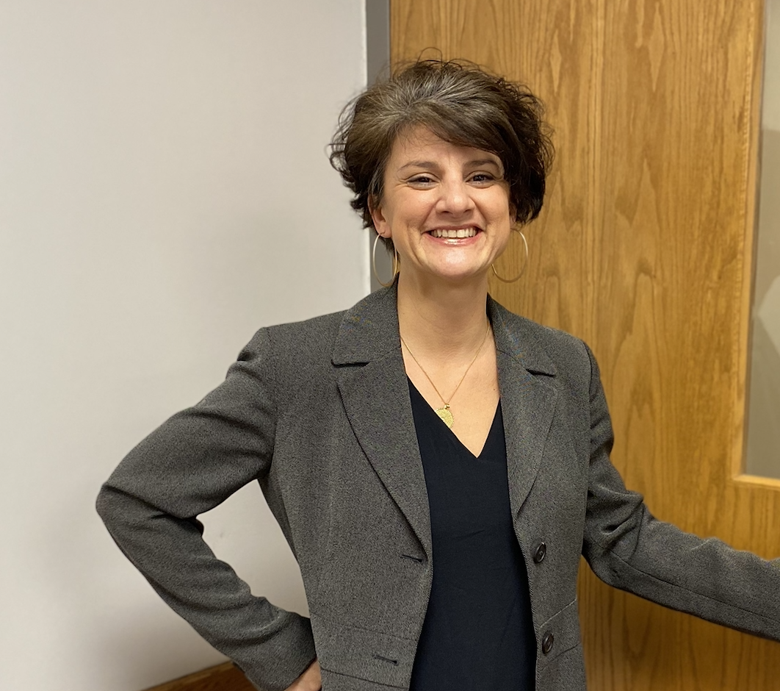
Civil Rights Office
Civil Rights Director
Christina Jones, J.D.
Lakeholm 109

Slide 23

SUPPORTIVE MEASURES
Regardless of when, where or with whom the conduct occurred, the University will offer resources and assistance to any individual who has been affected by Prohibited Conduct.
Non-disciplinary, non-punitive individualized services offered to both the complainant and respondent as appropriate, reasonably available, and without fee or charge.

Slide 24
Potential supportive measures, implemented on behalf of the complainant and/or the respondent to the extent reasonably available and warranted by the circumstances, include, but are not limited to:
Access to counseling and health services and assistance in setting up an initial appointment;
Imposition of a mutual “no-contact order” (failing to abide by the no-contact order may result in allegations of additional policy violations);
Altering housing or residence arrangements;
Altering work arrangements or job assignment for employees;
Providing campus escorts;
Providing transportation accommodations;
Offering adjustments to academic deadlines, course schedules, alternative course completion;
Limiting an individual’s or organization’s access to certain MVNU facilities or activities pending resolution of the matter;
Voluntary leave of absence;
Increased security and monitoring of certain areas of the campus;
Providing academic support services, such as tutoring;
MVNU-imposed administrative leave or separation;
MVNU-imposed restricted access; or
Other remedies that can reasonably be tailored to the involved individuals to achieve the goals of this policy.

Slide 25

Consent Defined
Must be informed, knowing and voluntary – freely given through clear words or action​
Cannot use force, threats, intimidating behavior, or coercion (unreasonable/persistent pressure).​
It cannot be given by someone known to be – or who should be known to be mentally or physically incapacitated.​
​
Consent requires the following conditions: ​
​
1. All parties are fully conscious.​
2. All parties are equally free to act.​
3. All parties have positively and clearly communicated their intent.

Slide 26

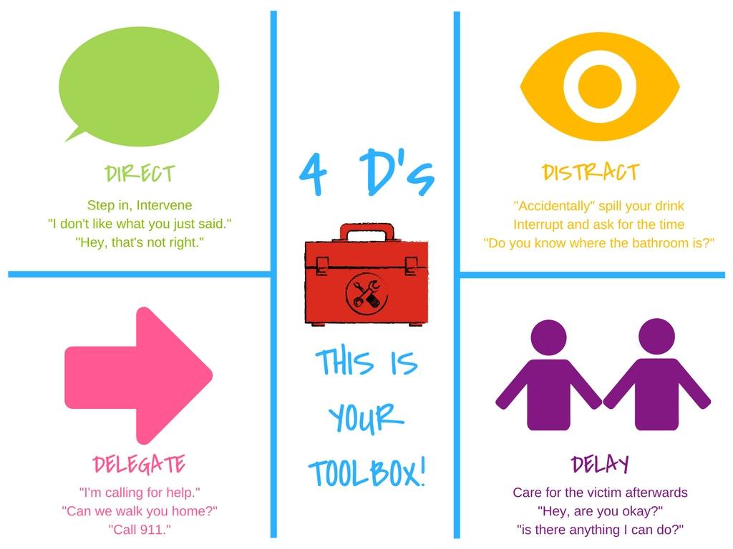
Bystander Intervention
Be a part of the SOLUTION

Slide 27
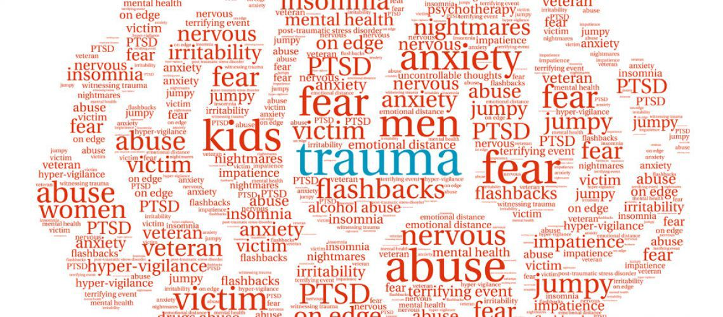
Recognizing Trauma
  Anxiety/Depression​
  Low self-esteem​
  Reinforcements of stereotypes​
  Flashbacks​
  Disrupted sleep, loss of concentration​
  Suicidal thoughts/self-harming ​
  Breakdown in trust
Dizziness​
Dilated pupils​
Dry mouth​
Muscle tension​
Hyperventilation​
Rapid Speech​
Anxiety​
Floods of Emotion​
Unfocused eyes​
Disassociation​
Low energy​
Non-responsive

Slide 28

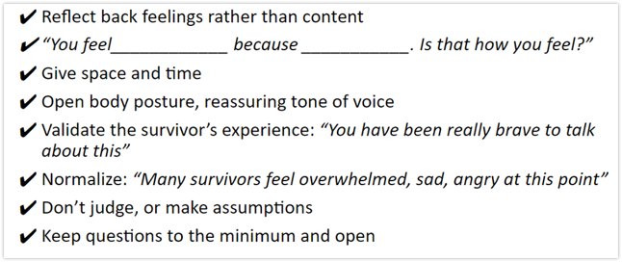
How do you help?
Be present, active listening, be patient​
Validate their feelings​
Offer resources​
  Counseling/Campus pastors, Title IX office support (adjust class schedules, police report, no-contact orders, room re-assignments, etc)

Slide 29

Building Culture
Pay attention to culture, and shut down conversations, jokes, actions, or media that you wouldn't want directed at you or a loved one.​
Step into situations that seem like they might be getting out of hand​
Continue to build trust and bonds with your group. ​
  In our student survey in 2016, 75% of people said they’d rather disclose to a friend than anyone else if they were to experience sexual violence.
Encourage healthy social media habits
Tie this respect culture into our faith discussions

Slide 30
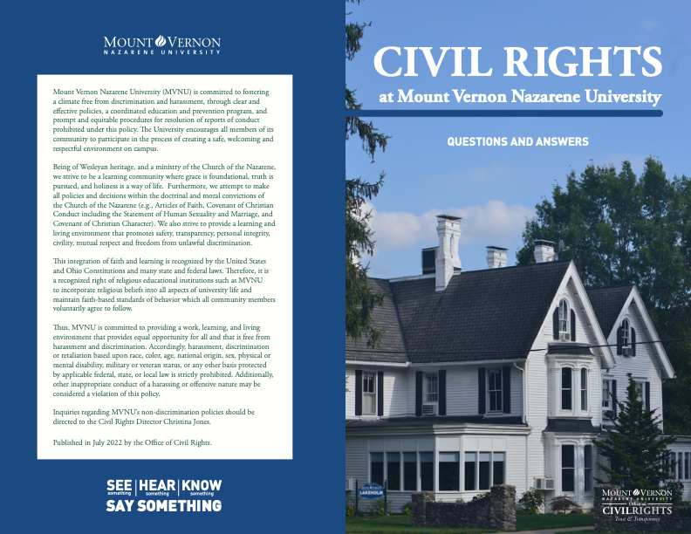
Check out the MVNU Civil Rights Brochure

Slide 31
For the complete policies, go to www.mvnu.edu/titleix
Amnesty
Reporting Options
Prohibited Conduct
Consent, Force, Coercion, Incapacitation
Relationships
Complaint Resolution Processes & Flowchart

